Slide 1
DO NOT REPRINT
© FORTINET
FortiAnalyzer Study
Guide
for FortiAnalyzer 6.2

Slide 2



DO NOT REPRINT
© FORTINET
Fortinet Training
http://www.fortinet.com/training Fortinet Document Library http://docs.fortinet.com
Fortinet Knowledge Base
http://kb.fortinet.com
Fortinet Forums
https://forum.fortinet.com
Fortinet Support
https://support.fortinet.com
FortiGuard Labs
http://www.fortiguard.com
Fortinet Network Security Expert Program (NSE)
https://www.fortinet.com/support-and-training/training/network-security-expert-program.html
Feedback
Email: courseware@fortinet.com
6/26/2019

Slide 3

DO NOT REPRINT
© FORTINET
TABLE OF CONTENTS
Introduction and Initial Configuration 4
Administration and Management 35
Device Registration and Communication 75
Logging 116
Reports 168
Supplementary Material 225 SQL and Datasets 226

Slide 4
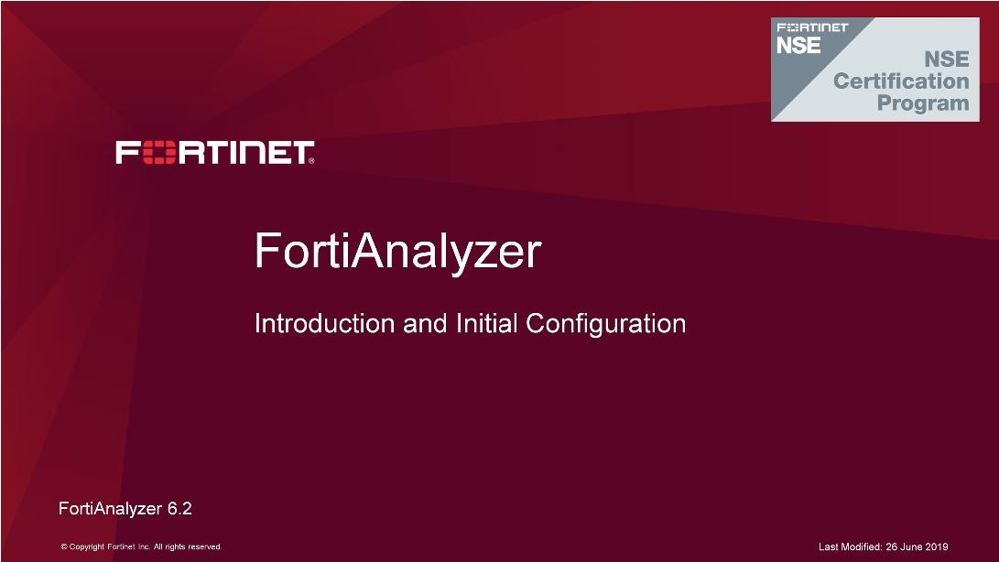
DO NOT REPRINT
© FORTINET
Introduction and Initial Configuration
In this lesson, you will learn about the key features and concepts of FortiAnalyzer and how to initially configure FortiAnalyzer.
FortiAnalyzer integrates logging, analytics, and reporting into one system so you can quickly identify and react to network security threats.

Slide 5
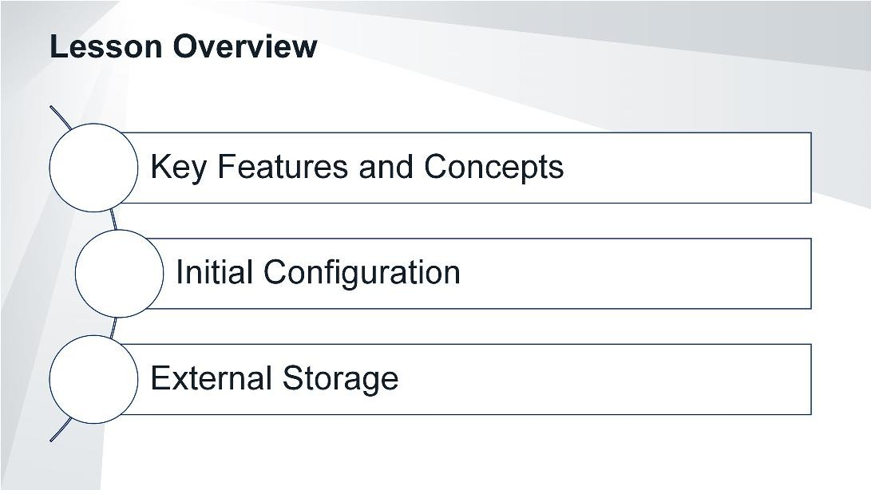
DO NOT REPRINT
© FORTINET
Introduction and Initial Configuration
In this lesson, you will explore the topics shown on this slide.

Slide 6
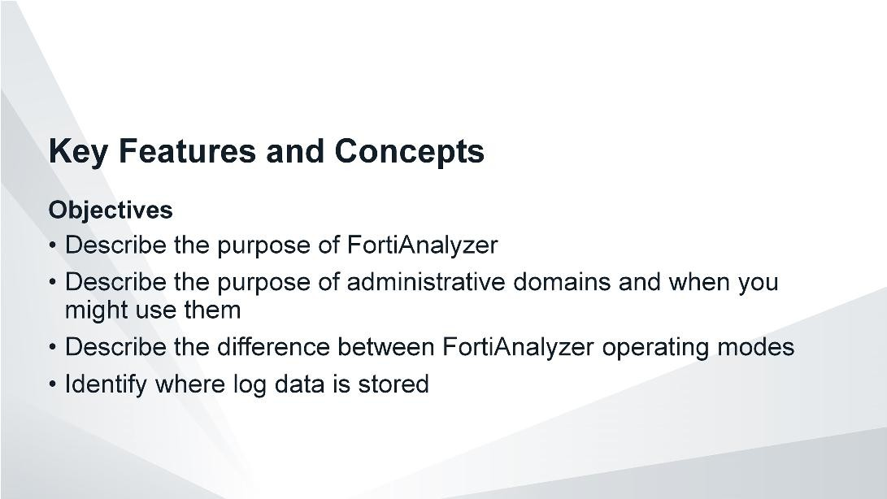
DO NOT REPRINT
© FORTINET
Introduction and Initial Configuration
After completing this section, you should be able to achieve the objectives shown on this slide.
By demonstrating competence in FortiAnalyzer’s key features and concepts, you will be able to use the device effectively in your own network.

Slide 7
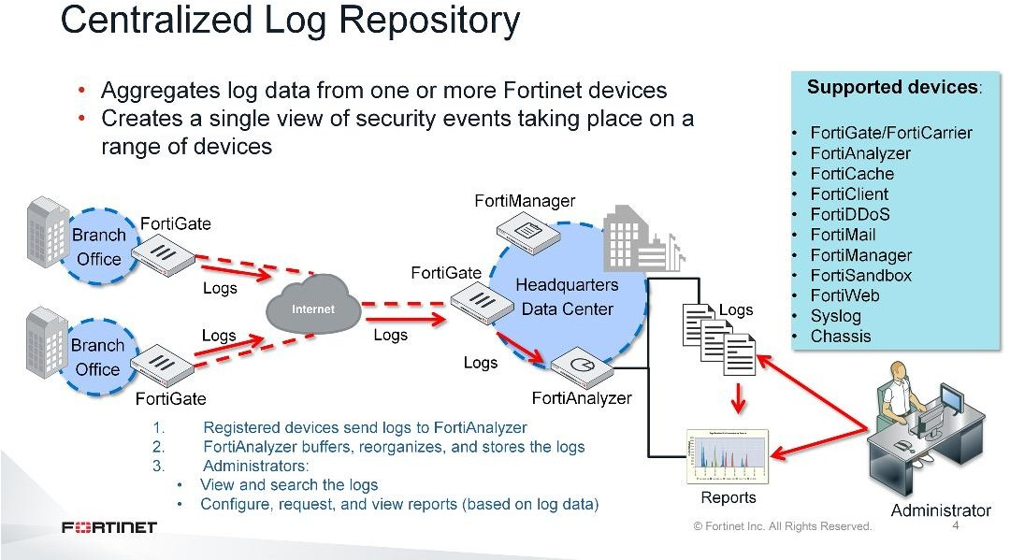
DO NOT REPRINT
© FORTINET
Introduction and Initial Configuration
FortiAnalyzer aggregates log data from one or more Fortinet devices, thereby acting as a centralized log repository. This provides a single channel for accessing your complete network data, so you don’t need to access multiple devices several times a day.
The logging and reporting workflow operates as follows:
Registered devices send logs to FortiAnalyzer.
FortiAnalyzer collates and stores those logs in a way that makes it easy to search and run reports.
Administrators can connect to FortiAnalyzer using the GUI to view the logs manually or look at the data in any generated report.

Slide 8
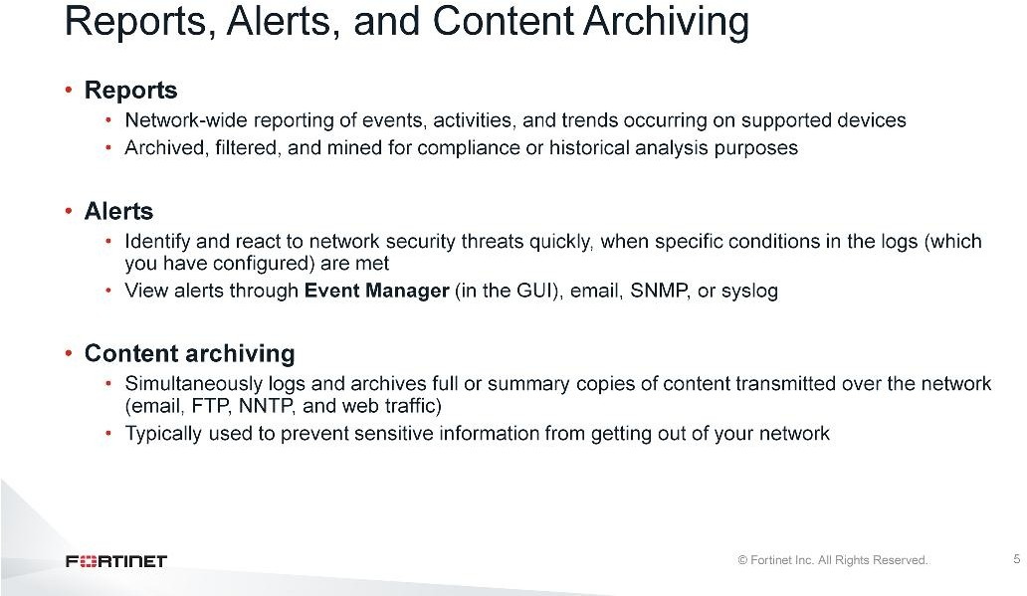
DO NOT REPRINT
© FORTINET
Introduction and Initial Configuration
Some key features of FortiAnalyzer include reporting, alert generation, and content archiving.
Reports provide a clear picture of network events, activities, and trends occurring on supported devices. FortiAnalyzer reports collate the information in the logs so that you can interpret the information and, if necessary, take action. You can archive and filter the network knowledge you glean from these reports, as well as mine it for compliance or historical analysis purposes.
FortiAnalyzer alerts allow you to react quickly to threats, because it’s not realistic to physically monitor your network around the clock. The system generates alerts when specific conditions in the logs are met— conditions you have configured FortiAnalyzer to monitor for registered devices. You can see your alerts on the GUI throughEvent Manager, and you can also send alerts to multiple recipients by email, SNMP, or syslog.
Content archiving provides a way to simultaneously log and archive full or summary copies of content transmitted over the network. You typically use content archiving to prevent sensitive information from getting out of your organization's network, you can also use it to record network use. The data leak prevention (DLP) engine can examine email, FTP, NNTP, and web traffic, but you must configure the archive setting for each rule in a DLP sensor on FortiGate, so you can specify what you want to archive.

Slide 9
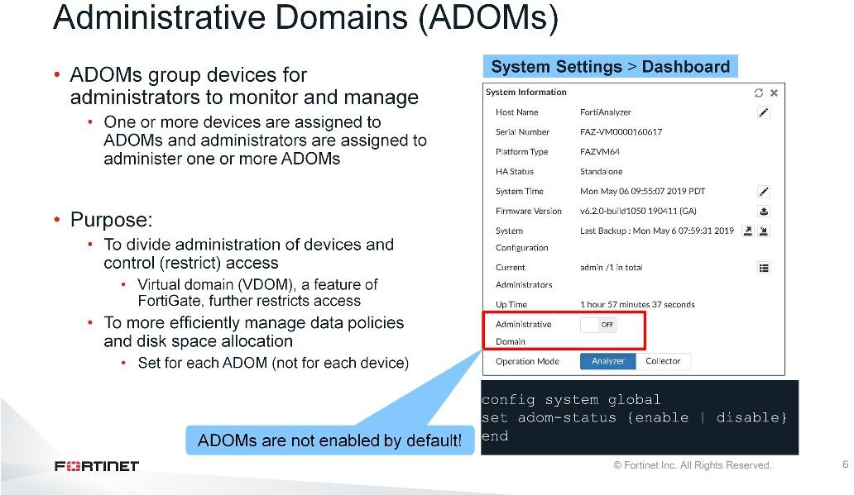
DO NOT REPRINT
© FORTINET
Introduction and Initial Configuration
ADOMs allow you group devices to monitor and manage. For example, administrators can manage devices specific to their geographical location or business division.
The purpose of ADOMs is to:
Divide administration of devices by ADOM and to control (restrict) administrator access. If your network uses virtual domains (VDOMs), ADOMs can further restrict access to data that comes from a specific device’s VDOM only.
More efficiently manage data policies and disk space allocation, which you set per ADOM
ADOMs are not enabled by default and can only be configured by the defaultadminadministrator (or an administrator who has the super user profile).

Slide 10
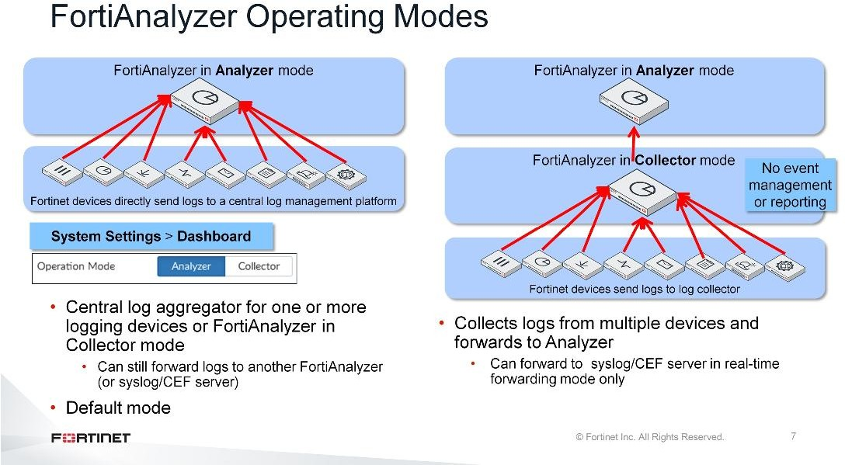
DO NOT REPRINT
© FORTINET
Introduction and Initial Configuration
FortiAnalyzer device has two modes of operation: analyzer and collector. The mode of operation you choose depends on your network topology and individual requirements.
When operating in analyzer mode, the device acts as a central log aggregator for one or more log collectors, such as a FortiAnalyzer device operating in collector mode, or any supported device sending logs. Analyzer is the default operating mode.
When operating in collector mode, the device collects logs from multiple devices and then forwards those logs, in their original binary format, to another device, such as a FortiAnalyzer operating in analyzer mode. (It can also send them to a syslog server or a common event format (CEF) server, depending on the forwarding mode.) A collector does not have the same feature-rich options as an Analyzer, because its only purpose is to collect and forward logs. It does not allow event management or reporting.
You can change the operating mode in theSystem Informationwidget on the dashboard.
By using both analyzer and collector modes, you increase FortiAnalyzer’s performance: Collectors off-load the task of receiving logs from multiple devices from the analyzer so it can expend its resources collating and storing those logs in a fashion that makes it easy to search and run reports. Furthermore, because a collector is strictly dedicated to log collection, its log receiving rate and speed are maximized. If bandwidth is an issue, you can use the store and upload option to send logs only during low-bandwidth periods.

Slide 11
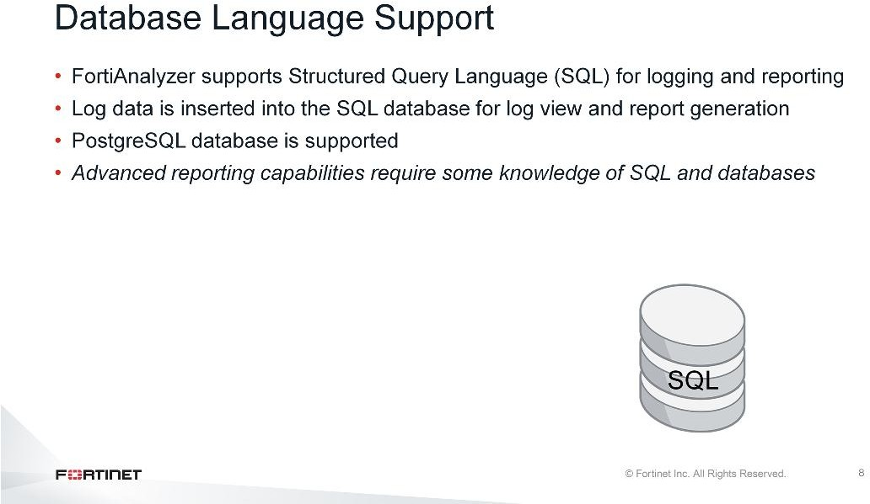
DO NOT REPRINT
© FORTINET
Introduction and Initial Configuration
SQL is the database language that FortiAnalyzer uses for logging and reporting.
Advanced reporting capabilities requires some knowledge of SQL and databases. For example, you may need to compose custom SQL queries, known as datasets, to extract the data you require from the database.

Slide 12
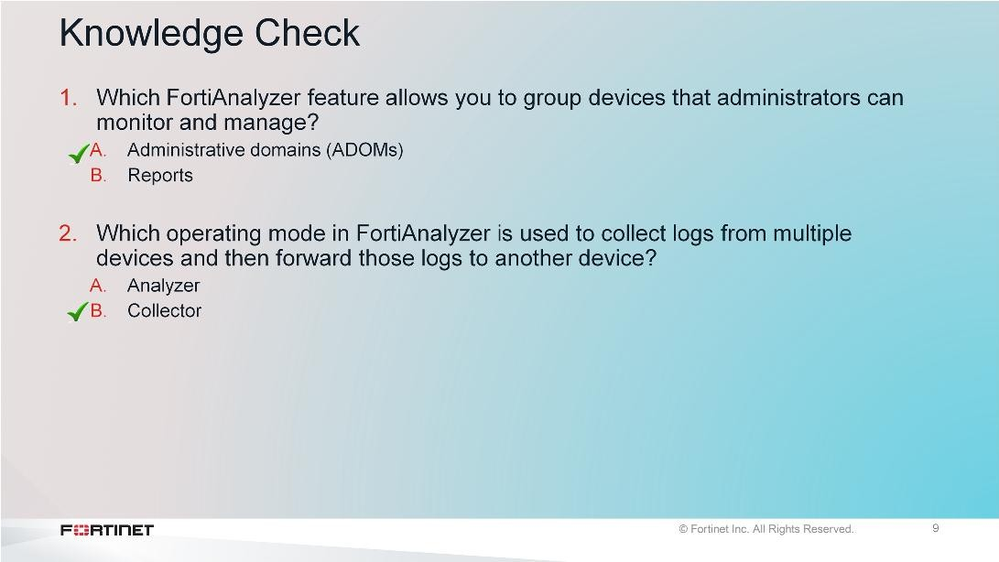
DO NOT REPRINT
© FORTINET
Introduction and Initial Configuration

Slide 13
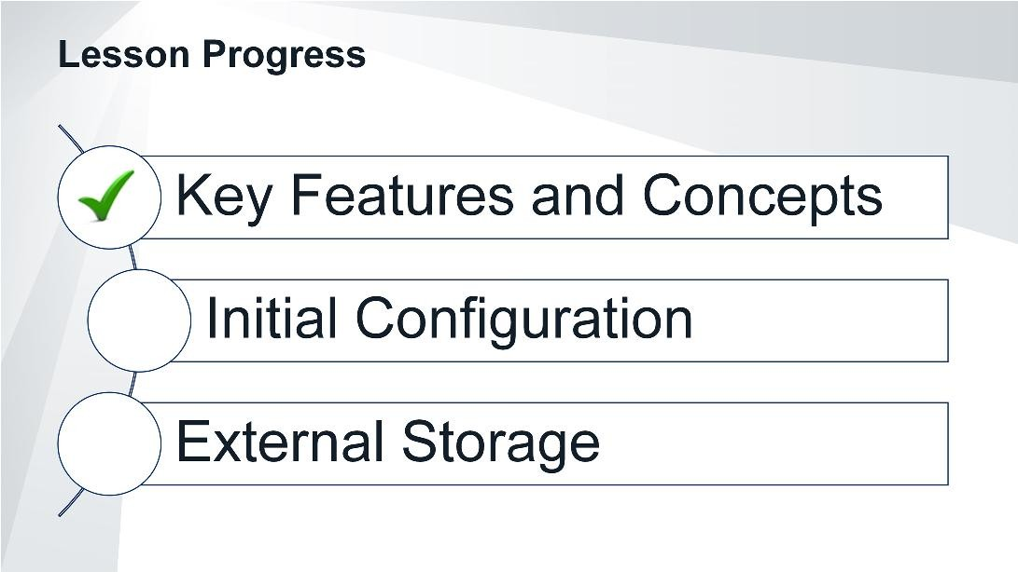
DO NOT REPRINT
© FORTINET
Introduction and Initial Configuration
Good job! You now understand FortiAnalyzer key features and concepts.
Now, you will learn how to initially configure FortiAnalyzer.

Slide 14
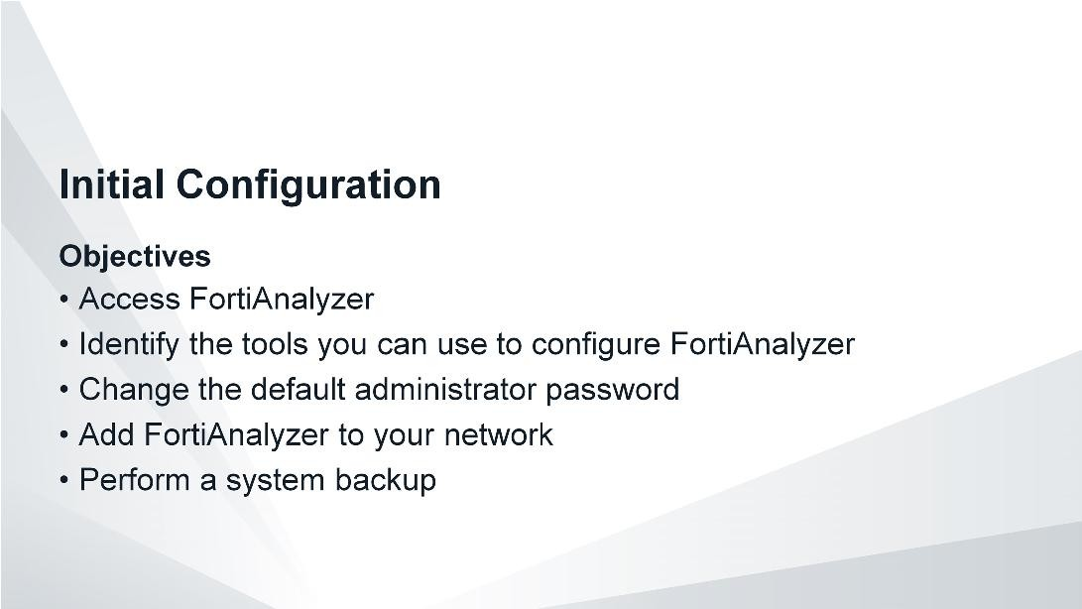
DO NOT REPRINT
© FORTINET
Introduction and Initial Configuration
After completing this section, you should be able to achieve the objectives shown on this slide.
By demonstrating competence in FortiAnalyzer’s initial configuration, you will be able to add FortiAnalyzer to your network and perform basic administrative tasks.

Slide 15
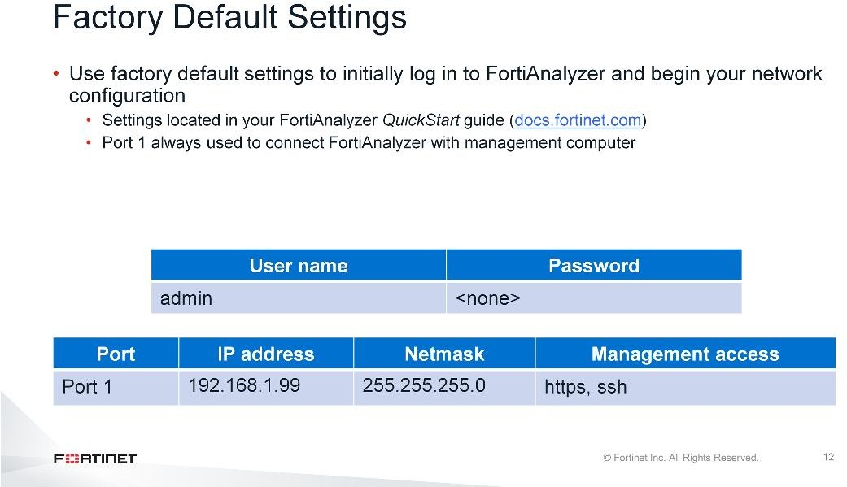
DO NOT REPRINT
© FORTINET
Introduction and Initial Configuration
It is important to know the factory default settings, such as the default user name and password, the port 1 IP address, the netmask, and the default supported management access protocols, so you can initially connect to the management computer and configure FortiAnalyzer for your network.
You can find the default settings in your model-specificQuickStart Guide.Different FortiAnalyzer models have different numbers of ports, but port 1 is the management port and always has this default IP.

Slide 16
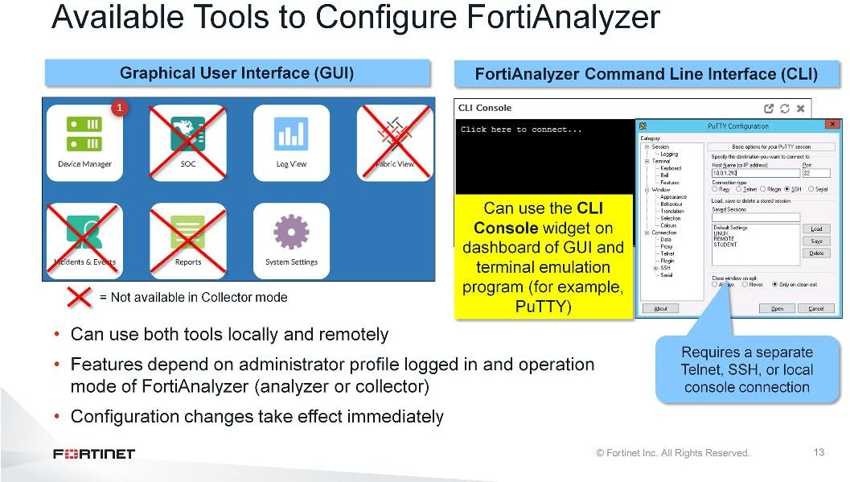
DO NOT REPRINT
© FORTINET
Introduction and Initial Configuration
Just like FortiGate, the GUI and CLI are the two configuration tools you can use to configure and manage FortiAnalyzer. You can use both tools locally, by connecting directly to FortiAnalyzer, and remotely, based on your configured settings. (You can deny or permit access based on IP address.) When you use the CLI, you can run commands through theCLI Consolewidget, available on the GUI dashboard, and through a terminal emulation application, such as PuTTY. Using PuTTY requires a separate Telnet, SSH, or local console connection.
The FortiAnalyzer features available in the GUI and CLI depend on the administrator profile logged in, and the operation mode of FortiAnalyzer. For example, when operating in collector mode, the GUI doesn’t include FortiView,Event Manager,Reports, or SOC. Also, if you are logged in with the Standard_User or Restricted_User administrator profiles, full access privileges, like those granted to the Super_User profile, are not available. The CLI also includes some settings that are not available through the GUI.
Any configuration changes you make using the GUI and CLI take effect immediately, without resetting the FortiAnalyzer system or interrupting service.
Note that the SQL database is disabled by default when FortiAnalyzer is in collector mode so logs that require the SQL database are not available in collector mode unless the SQL database is enabled on the CLI.

Slide 17
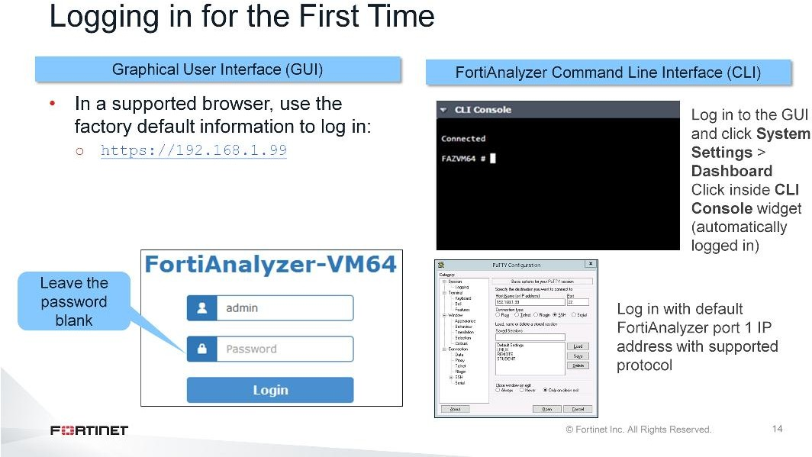
DO NOT REPRINT
© FORTINET
Introduction and Initial Configuration
To log in to the FortiAnalyzer GUI for the first time, open a browser and enter the URLhttps://followed by
<the factory default IP address>. Once the login screen opens, use the factory default administrator credentials to log in. The userid isadmin(in lower case) and leave the password field empty.
To log in to the CLI for the first time, you can use one of two methods:
CLI Consolewidget: Log in to the GUI and go toSystem Settings. The widget is available from the dashboard. Once you click anywhere on the console area, you can begin running CLI commands. (You are automatically logged in.)
Terminal emulation application (such as PuTTY): Enter the default FortiAnalyzer port 1 IP address and select a supported management access protocol, such as SSH. When connected to the IP and prompted to log in, use the factory default administrator credentials.

Slide 18
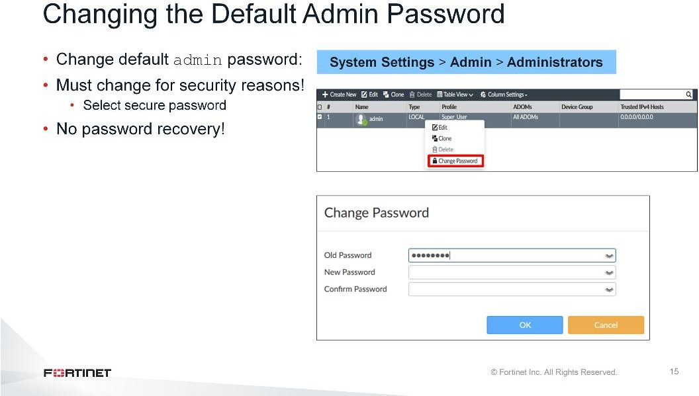
DO NOT REPRINT
© FORTINET
Introduction and Initial Configuration
For security reasons, one of the first tasks you should perform is changing the defaultadminpassword. From theAdministratorspage, right-click the admin user and selectChange Password. Make sure you enter a secure password.
Be aware that there is no password recovery option for FortiAnalyzer. If you forget your password and lose access to FortiAnalyzer, one option is to use theexecute migratecommand that allows backup of the configuration file to be loaded.
Follow these steps:
Perform a factory reset on the VM/appliance.
Run the exec migrate command.
The default admin account and password can still be used (system settings are not restored).
The other option is formatting the flash and reloading the image (from the BIOS configuration menu). This will erase the system settings and including the administrative accounts.
So ensure you remember your password or store it in a secure location.

Slide 19
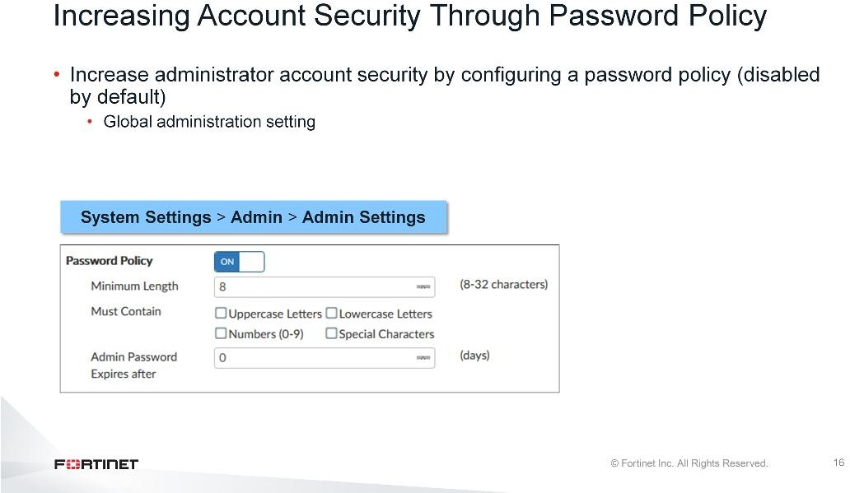
DO NOT REPRINT
© FORTINET
Introduction and Initial Configuration
You can increase the security of your administrator accounts by configuring a global password policy for all administrators on theAdmin Settingspage. By default, the password policy is disabled.
The policy allows you to set a minimum password length, specify if characters or numbers must be included in the password, and specify the number of days for which a password remains valid. If you do set a password expiry, ensure you adhere to the policy and change the password before it expires, because there is no password recovery option.

Slide 20
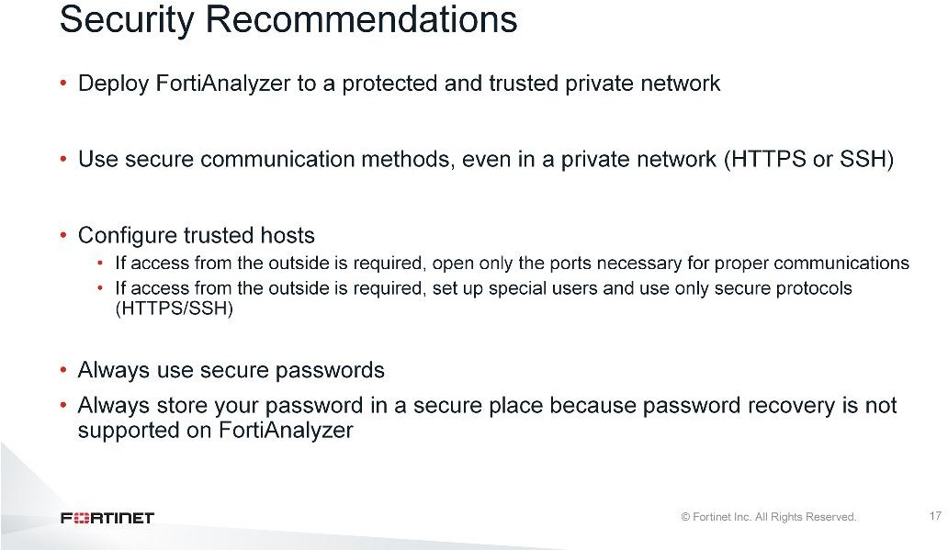
DO NOT REPRINT
© FORTINET
Introduction and Initial Configuration
Before reviewing the configuration settings, it is necessary to discuss the importance of security. FortiAnalyzer stores your network log information, so it isvitalthat data is properly protected.
Here are some security recommendations:
Deploy FortiAnalyzer in a protected and trusted private network. It should never be deployed outside the network.
Always use secure connection methods for administration: HTTPS for the GUI, or SSH for the CLI. Unsecure methods (like HTTP or telnet) are plain text, so an attacker can use packet sniffing tools to obtain information useful for breaching your network.
Use trusted hosts on your users and allow logins only from specific locations. If you do need to open outside access to the device so that remote FortiGate devices can connect, open only the ports necessary for this. Additional open ports increases your security risk. If you need to open direct login access from the outside, be sure to set up special user accounts for this and open only protocols that are secure. Use a secure password because they are important if you start transmitting traffic over connections that anyone (that is, the Internet) could be listening to.
Make sure you store your administrator password in a secure place because password recovery is not supported on FortiAnalyzer.

Slide 21
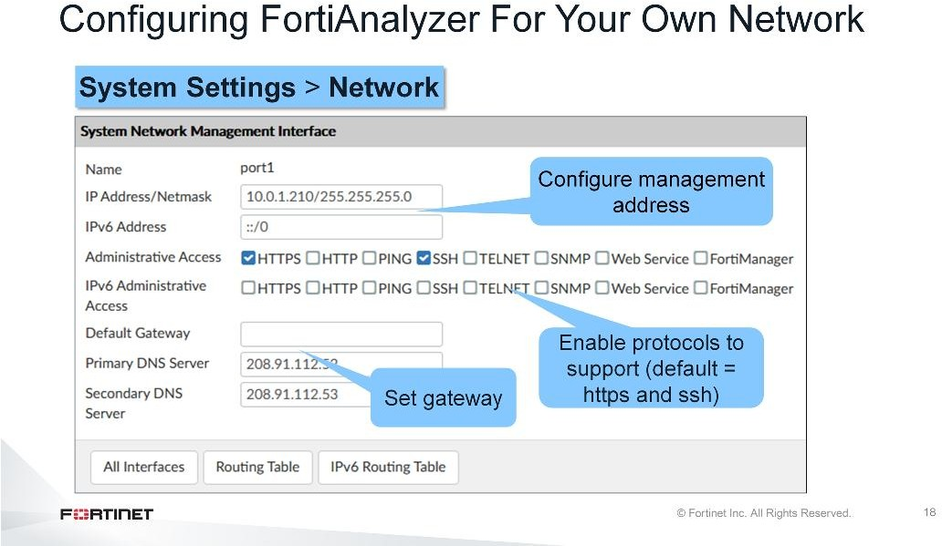
DO NOT REPRINT
© FORTINET
Introduction and Initial Configuration
The initial configuration of FortiAnalyzer is very similar to FortiGate. In order to configure FortiAnalyzer for your network, you must set the IP address and netmask, select supported administrative access protocols, and specify a default gateway for routing packets. You can do all this on theNetworkpage.
Setting your own IP and netmask provides more security than using the default address and, if more than one FortiAnalyzer is located in the network, different network settings are mandatory. The management interface must have a dedicated (unique) address.
There are a fewnon-standardadministrative access protocols that are worth mentioning as well:
Web Service: Allows access to FortiAnalyzer from a Web service such as SOAP, a messaging protocol that allows programs that run on disparate operating systems (such as Windows and Linux). The FortiAnalyzer server runs in Linux.
FortiManager: Allows FortiAnalyzer to be managed by a FortiManager.

Slide 22
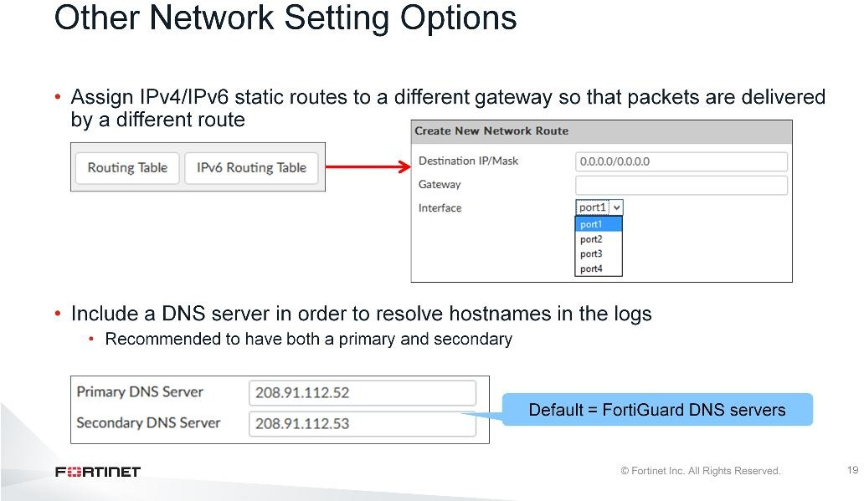
DO NOT REPRINT
© FORTINET
Introduction and Initial Configuration
If you want to configure another port on FortiAnalyzer, you can assign specific IPv4 or IPv6 static routes to a different gateway, so that packets are delivered by a different route.
If you want to be able to resolve hostnames in the logs, a DNS server is required. The default primary and secondary DNS server addresses are the FortiGuard DNS servers. You can use these addresses or change them to something else, but the servers must be on the networks to which FortiAnalyzer connects. It is a best practice to have both a primary and secondary addresses. Furthermore, response times are a consideration for DNS, so choose DNS IPs as close as possible to your network, such as your Internet provider’s DNS.

Slide 23
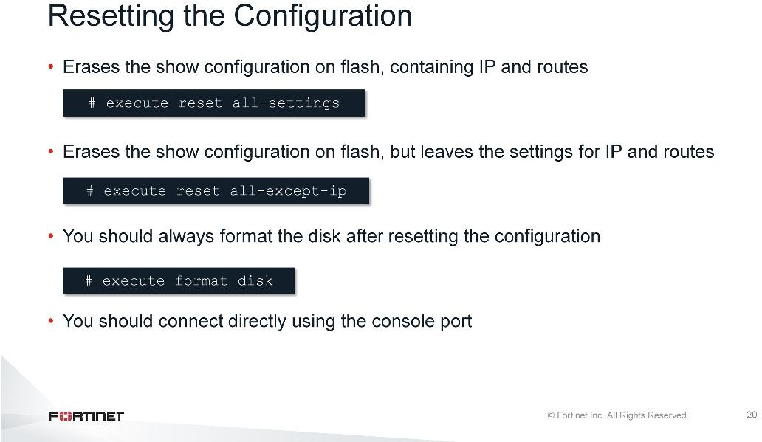
DO NOT REPRINT
© FORTINET
Introduction and Initial Configuration
If you need to reset your configuration, you can use these commands. Theexecute reset all- settingscommand erases the show configuration on flash, containing the IP and routes, while the execute reset all-except-ipcommand leaves the settings for IP and routes.
After resetting a configuration, you should always reformat the disk using theexe format diskcommand. It is a best practice to connect directly using the console port.

Slide 24
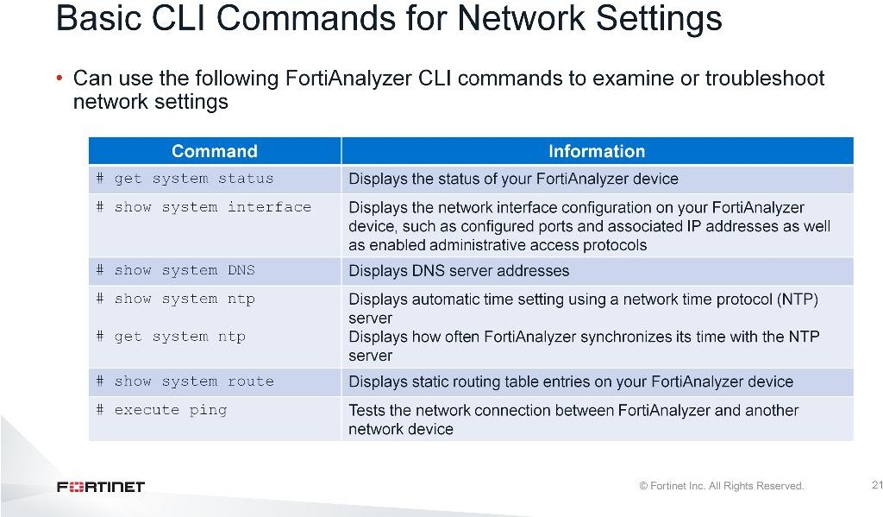
DO NOT REPRINT
© FORTINET
Introduction and Initial Configuration
You can use the CLI commands shown on this slide to examine or troubleshoot network settings on FortiAnalyzer.

Slide 25
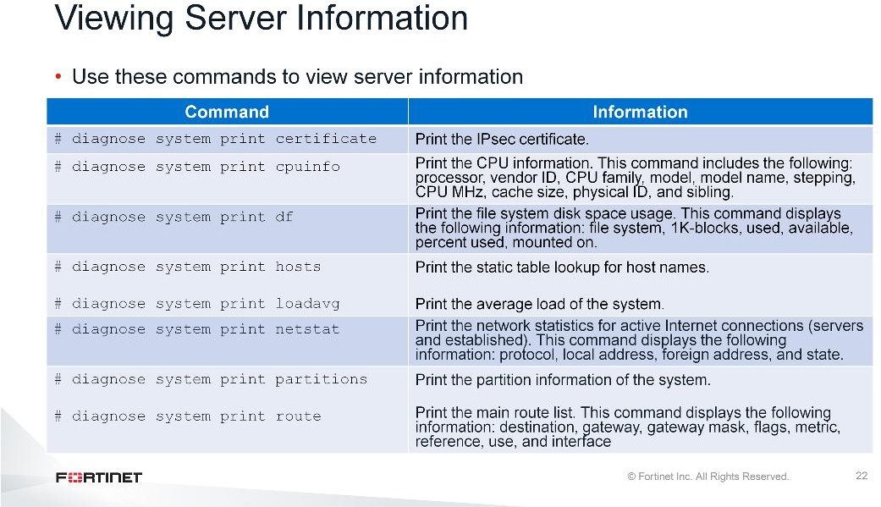
DO NOT REPRINT
© FORTINET
Introduction and Initial Configuration
To access and view server-related information, use thediagnose system printcommands. For a complete list of commands , refer to theFortiAnalyzer CLI Reference, which you can obtain from https://docs.fortinet.com.

Slide 26
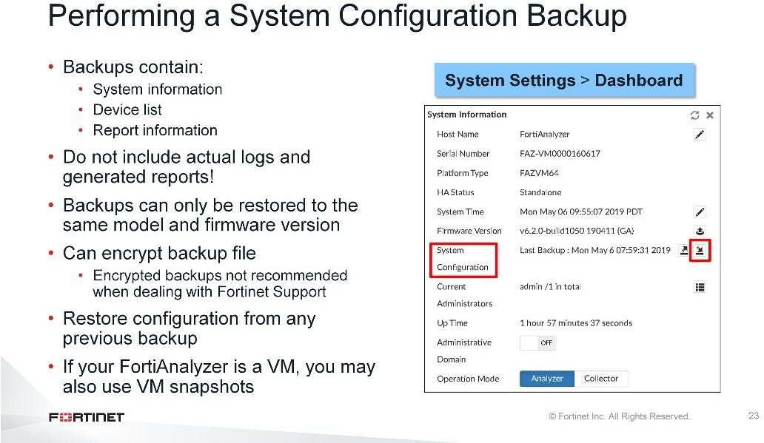
DO NOT REPRINT
© FORTINET
Introduction and Initial Configuration
After you’ve completed your initial configuration, you should back it up as a best practice. You can perform a backup directly on the GUI using theSystem Informationwidget.
The backup contains everythingexcept the actual logs and generated reports. What does the backup include?
System information, such as the device IP and administrative user information.
Device list, such as any devices you configured to allow log access.
Report information, such as any configured report settings, as well as all of your custom report details.
You can save the backup file as an encrypted file for additional security, but be aware that you can restore an encrypted backup only to the same model and firmware version. Furthermore, if you require assistance from Fortinet Support and your configuration is required to assist with troubleshooting, your backup should not be encrypted.
If changes are made to FortiAnalyzer that ends up negatively affecting your network, you can restore the configuration from any of your backups.
If your FortiAnalyzer is a VM, you can also use VM snapshots.

Slide 27
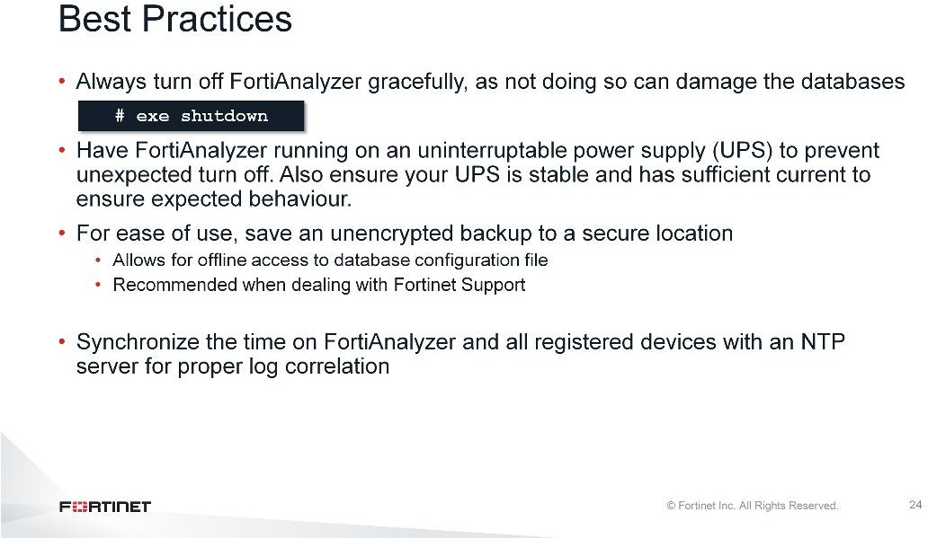
DO NOT REPRINT
© FORTINET
Introduction and Initial Configuration
The following are some best practices for operating FortiAnalyzer:
Always turn off FortiAnalyzergracefullybecause not doing so can damage the databases
Have FortiAnalyzer running on an uninterruptable power supply (UPS) to prevent unexpected turn off. Also ensure your UPS is stable and has sufficient current to ensure expected behaviour.
For ease of use, save an unencrypted backup to a secure location. You should use an unencrypted backup when dealing with Fortinet Support because it allows for offline access to the database configuration file.
Synchronize the time on FortiAnalyzer and all registered devices with an NTP server for proper log correlation

Slide 28
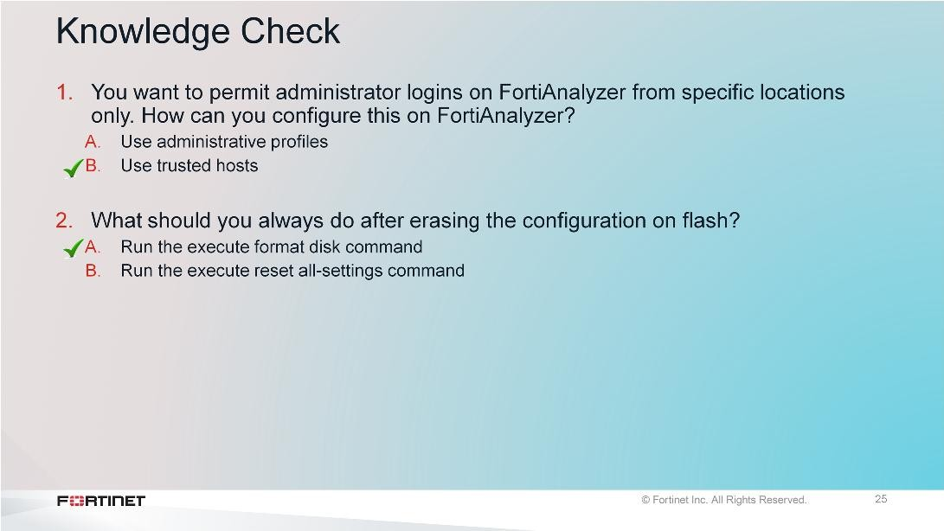
DO NOT REPRINT
© FORTINET
Introduction and Initial Configuration

Slide 29
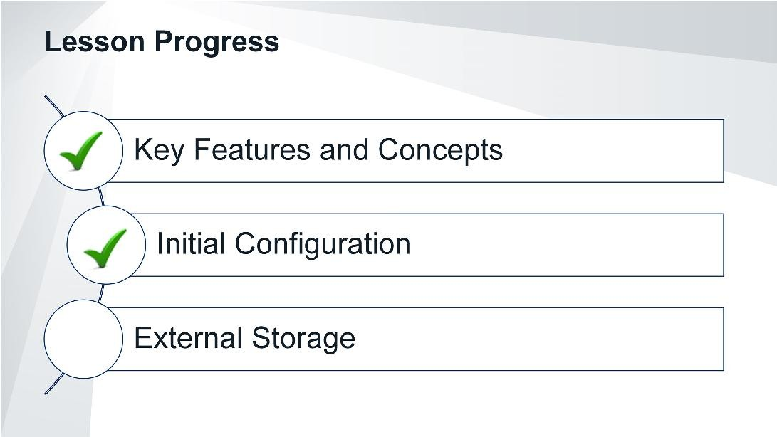
DO NOT REPRINT
© FORTINET
Introduction and Initial Configuration
Congratulations! You have completed this lesson.

Slide 30
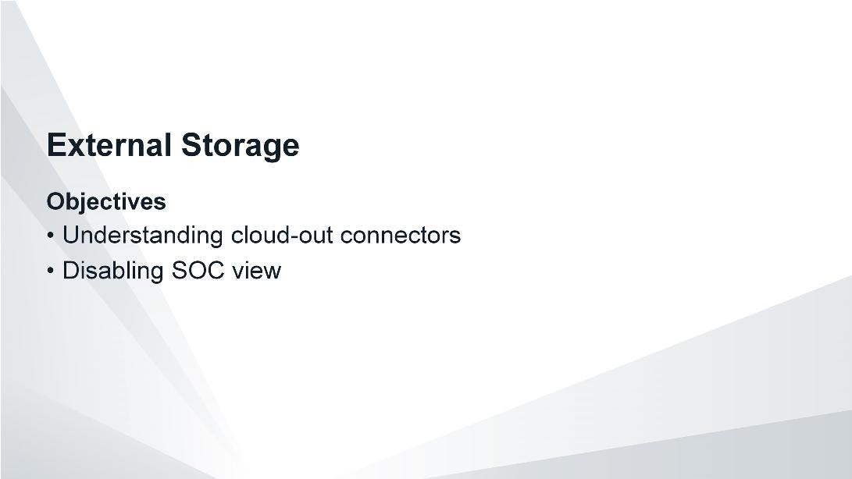
DO NOT REPRINT
© FORTINET
Introduction and Initial Configuration
After completing this section, you should be able to achieve the objectives shown on this slide.
By demonstrating competence in FortiAnalyzer’s cloud-out connectors, you will be able to configure FortiAnalyzer to send logs to cloud platforms.

Slide 31
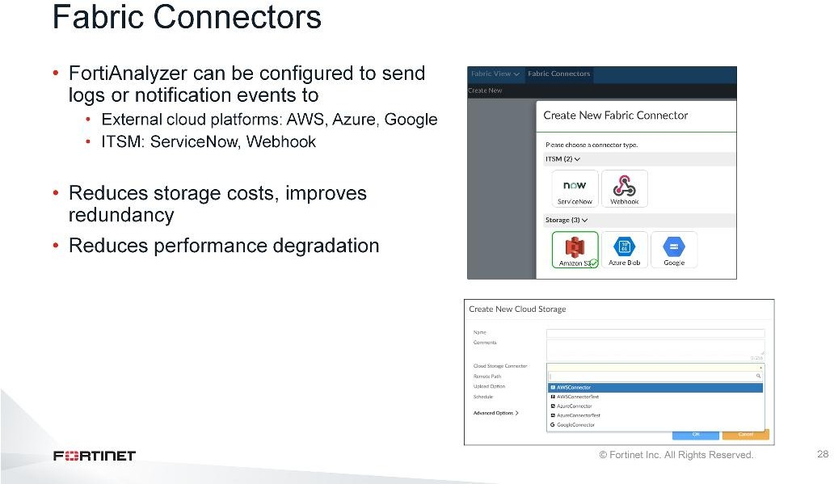
DO NOT REPRINT
© FORTINET
Introduction and Initial Configuration
Cloud-Out Connector allows you to back up data (rolled logs) to public cloud accounts in Amazon (S3), Microsoft Azure and Google Cloud.
Support for this feature requires you to configure the following components in FortiAnalyzer:
Create a Fabric Connector for Amazon S3, Microsoft Azure or Google Cloud
Configure cloud storage
Fabric Connectors feature will also enable FortiAnalyzer to send notifications to ITSM platforms upon new incident creation or any subsequent update. This approach is more efficient than third-party platforms polling information from FortiAanalyzer API in pre-defined intervals which could result in FortiAnalyzer performance degradation.

Slide 32
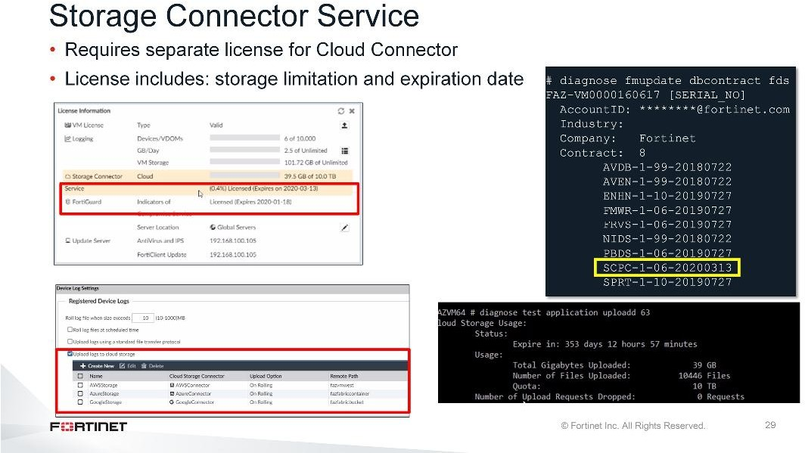
DO NOT REPRINT
© FORTINET
Introduction and Initial Configuration
In order to use to send logs to cloud platforms, you will have to buy separate license forStorage Connector Service. This license includes:
Storage Limitation: Amount of data that can be uploaded to cloud platform Expiry date: Date up to which the storage data can be sent
Note that if uploaded logs reach data storage limitation prior to the license expiration, license renewal is needed in order to continue to use this service.
Once the license is uploaded, you can enable theUpload logs to cloud storagefeature underSystem Settings>Device Log Settingsand select the cloud storage platforms that the data will be sent to.
diagnose fmupdate dbcontract fdscommand can be used to find out about the license validity and expiry details.
diagnose test application uploadd 63command gives details such as usage quota, total data
upload in GigaBytes, total number of files uploaded, number of days remaining until license expiry and number of uploaded requests that were dropped.

Slide 33
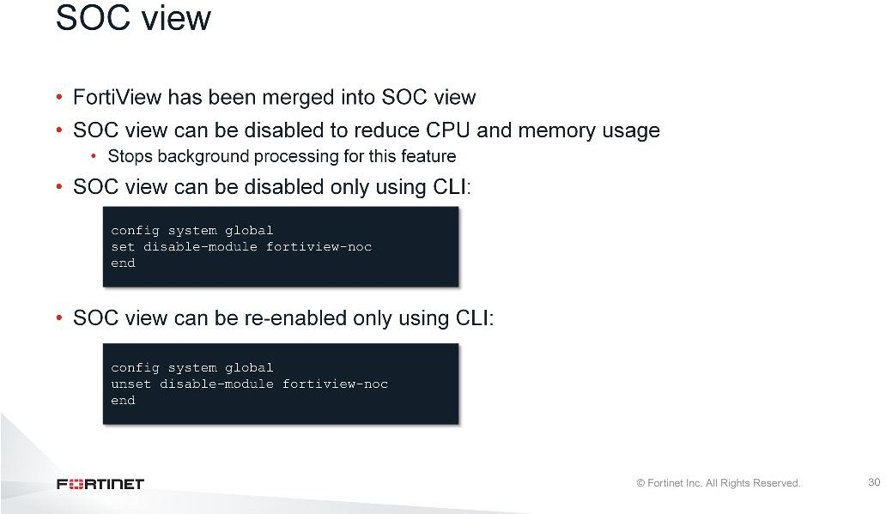
DO NOT REPRINT
© FORTINET
Introduction and Initial Configuration
In 6.2, the FortiView and NOC-SOC modules have been merged into SOC view.
To allow tuning of CPU and memory usage in high capacity environments, a new option has been added to disable SOC view, which stops the background processing for this feature.
On FortiAnalyzer, the SOC module can be disabled from the CLI with: config system global - set disable- module fortiview-noc.
Once disabled, the GUI will hide the SOC module, including FortiView and Monitors.
On FortiGate, if the FAZ SOC module is disabled, when FortiGate attempts to retrieve FortiView data from FortiAnalyzer, FortiAnalyzer will return the message: Server Error: FortiView\/NOC function is disabled on FortiAnalyzer.
The FortiGate GUI will display the message: Failed to retrieve FortiView data.

Slide 34
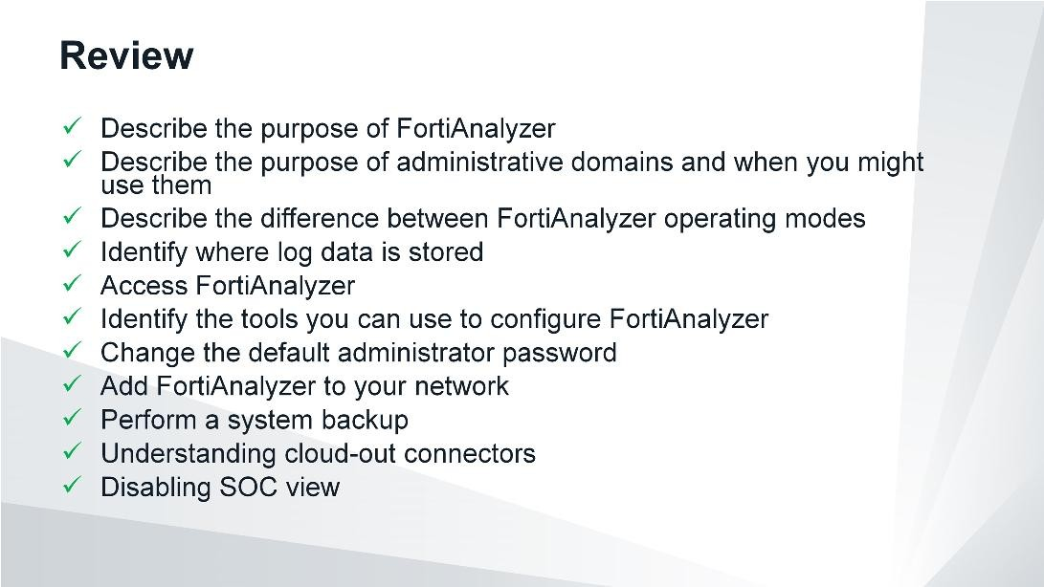
DO NOT REPRINT
© FORTINET
Introduction and Initial Configuration
This slide shows the objectives that you covered in this lesson.

Slide 35

DO NOT REPRINT
© FORTINET
Administration and Management
In this lesson, you will learn some administration and management functions you can use to better defend FortiAnalyzer—and the sensitive log data it stores—against external or internal threats.

Slide 36
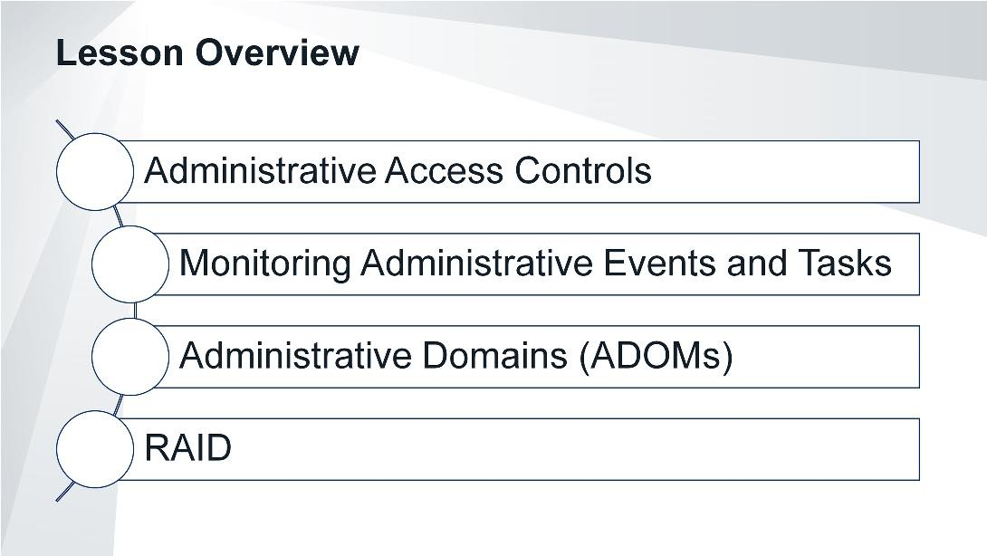
DO NOT REPRINT
© FORTINET
Administration and Management
In this lesson, you will explore the topics shown on this slide.

Slide 37
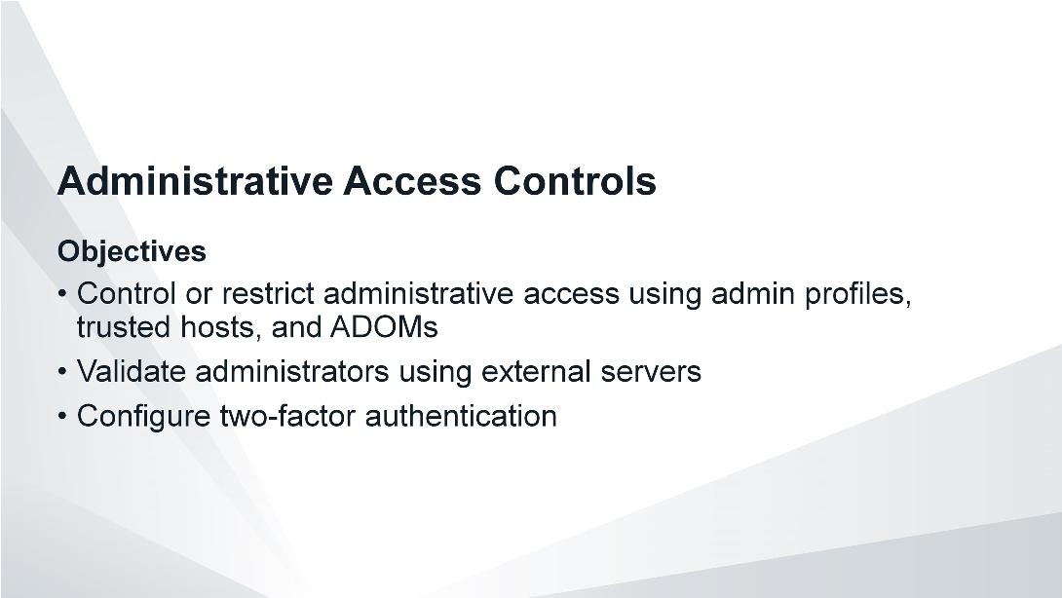
DO NOT REPRINT
© FORTINET
Administration and Management
After completing this section, you should be able to achieve the objectives shown on this slide.
By demonstrating competence in using administrative access controls, you will be able to better safeguard the administration and management of your FortiAnalyzer device and the sensitive data it collects.

Slide 38
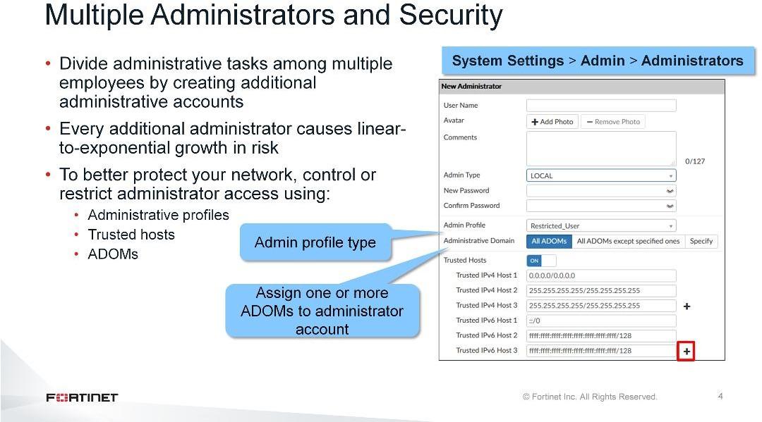
DO NOT REPRINT
© FORTINET
Administration and Management
Depending on your deployment, you may want to divide FortiAnalyzer administrative tasks among multiple employees by creating additional administrative accounts. However, every additional individual to which you give administrator access causes linear-to-exponential growth in risk.
In order to protect your network, you can control and restrict administrative access using the following methods:
Administrative profiles
Trusted hosts
Administrative domains (ADOMs)
By giving administrative access to multiple people, and employing methods of control, you can better protect your network.

Slide 39
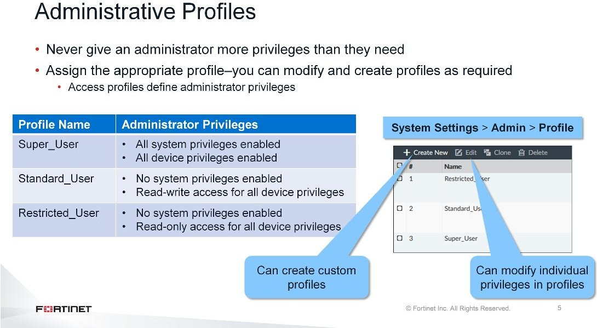
DO NOT REPRINT
© FORTINET
Administration and Management
You should never give administrators more privileges than they need to fulfill their role. As such, FortiAnalyzer comes with three preinstalled default profiles that you can assign to other administrative users. Administrator profiles define administrator privileges, and are required for each administrative account. The three default profiles are:
Super_User, which, like FortiGate, provides access to all device and system privileges
Standard_User, which provides read and write access to device privileges, but not system privileges
Restricted_User, which provides read access only to device privileges, but not system privileges.
You can assign the default profiles to administrative accounts, or you can modify the individual privileges associated with each default profile. Alternatively, you can create your own custom profiles.

Slide 40
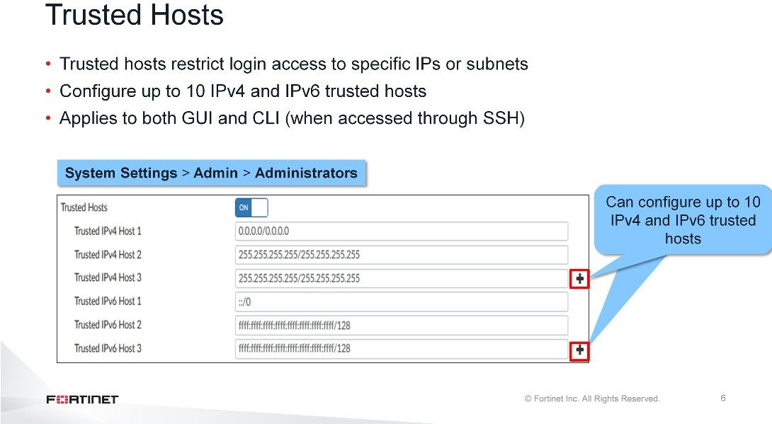
DO NOT REPRINT
© FORTINET
Administration and Management
In addition to controlling administrative access through administrator profiles, you can further control access by setting up trusted hosts for each administrative user. This restricts administrators to logins from only specific IPs or subnets. You can even restrict an administrator to a single IP address, if you define only one trusted host IP.
The trusted hosts you define apply to both the GUI and the CLI when accessed through SSH.

Slide 41
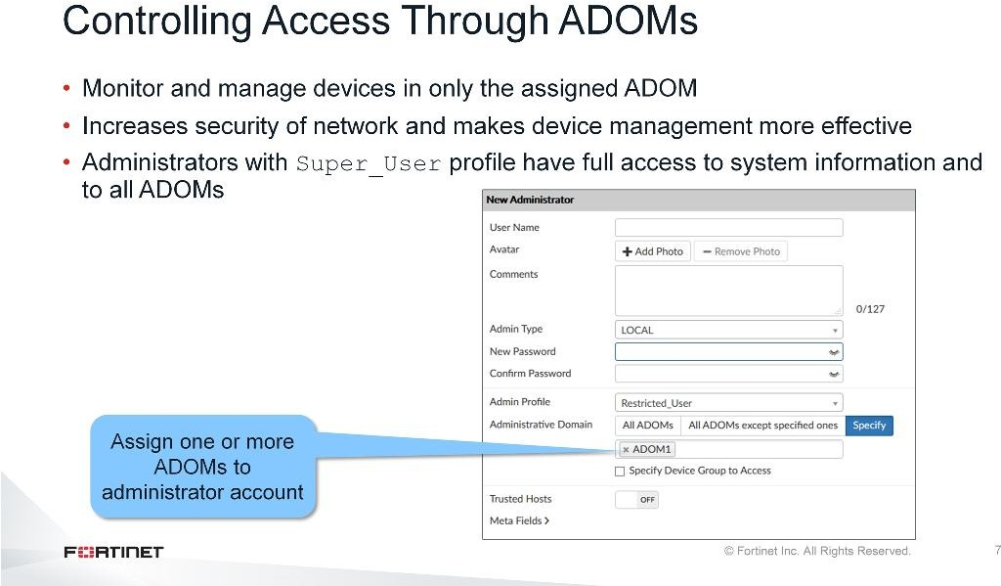
DO NOT REPRINT
© FORTINET
Administration and Management
Another way you can control administrative access is through ADOMs. Using ADOMs makes device management more effective, as administrators need only to monitor and manage devices in their assigned ADOM. It also makes the network more secure, as administrators are restricted to only those devices to which they should have access. The security risk increases as you open up and expose more of your network.
Administrators who have theSuper_Userprofile have full access to all ADOMs. Administrators with any other profile have access to only those ADOMs to which they are assigned—this can be one or more.

Slide 42
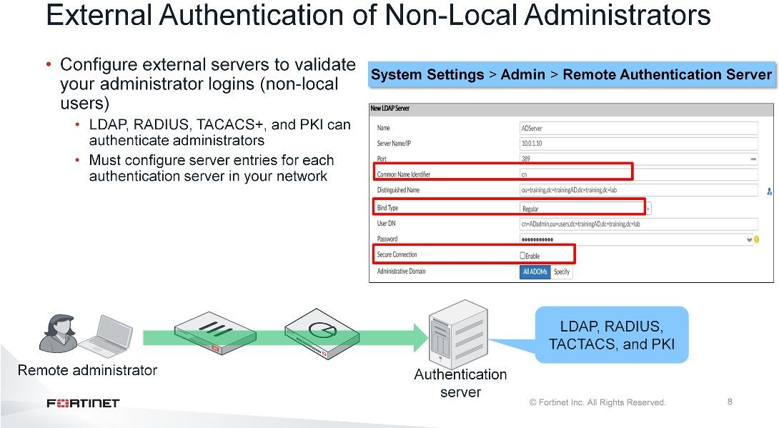
DO NOT REPRINT
© FORTINET
Administration and Management
Instead of creating local administrators, where logins are validated by FortiAnalyzer, you can configure external servers to validate your administrator logins. RADIUS, LDAP, TACACS+, and PKI can all be used to authenticate administrators.

Slide 43
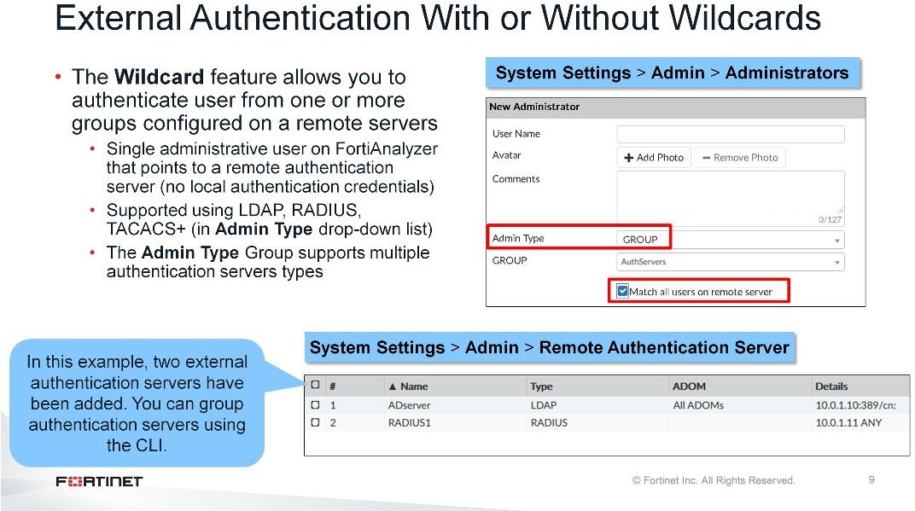
DO NOT REPRINT
© FORTINET
Administration and Management
You can also use the Wildcard account feature to enable administrators to log in to FortiAnalyzer by using their credentials on a remote authentication server, such as RADIUS, TACACS+, and LDAP. FortiAnalyzer does not require local credentials if a remote server is being used. This simplifies administration. For example, if an employee leaves the company, their account does not exist on FortiAnalyzer––they exist only as a user on a remote authentication server. However, if you do not select Wildcard, you will need to provide a password. This password is used only if FortiAnalyzer is unable to connect to the authentication server.
Note that starting v6.0, multiple wildcard accounts are permitted.
You can see remote authentication server groups, which are listed asGroupin theAdmin Typedrop-down
list, to extend administrator access. Usually, you can create a wildcard administrator only for a single server. If you group multiple servers of different types, you can apply a wildcard administrator to all the servers in the group. If you added an LDAP and RADIUS server to your authentication group and the administrator had login credentials on both of these servers, then the administrator could authenticate on FortiAnalyzer using either their LDAP or RADIUS credentials.
You can group multiple servers of the same type (for example, all LDAP servers) to act as backup—if one server fails, the administrator can still be authenticated by another server in the group. You can add remote authentication server groups only using the CLI. In the example on the slide, two existing authentication servers were added, an LDAP and a RADIUS server. On the CLI, an authentication server group was added and namedAuthServers. Then, the servers were added to this group.

Slide 44
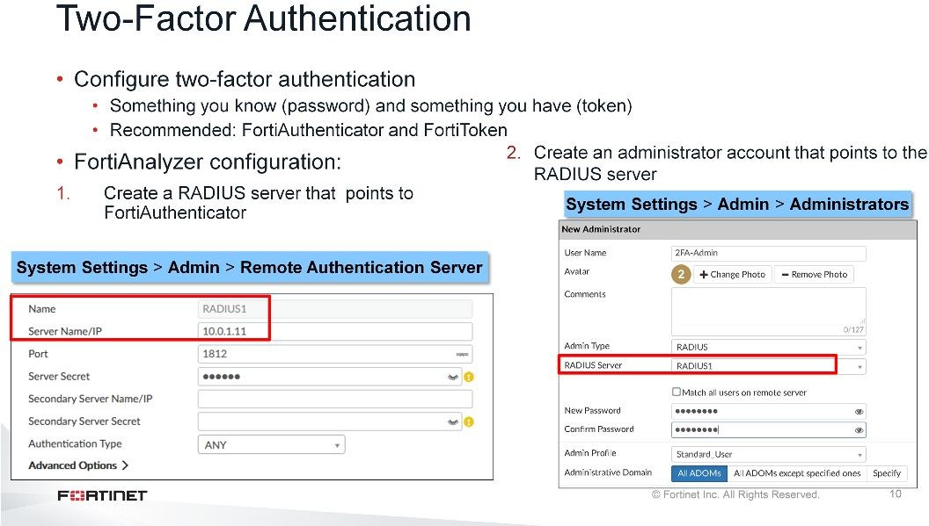
DO NOT REPRINT
© FORTINET
Administration and Management
To add additional security to external administrators, you can configure two-factor authentication. To do this, it is recommended you use FortiAuthenticator and FortiToken. It is possible to use third-party RADIUS and RSA tokens.
On the FortiAnalyzer side, you need to create a RADIUS server that points to FortiAuthenticator and then create an administrator account that points to the RADIUS server. Only one wildcard account is permitted.
In addition to using a password and token, you can use a password plus digital certificate. When using PKI as a means to authenticate, you have the choice of two-factor authentication or certificate-only.
For more information about configuring external servers and two-factor authentication, see theFortiAnalyzer Administration Guide.

Slide 45
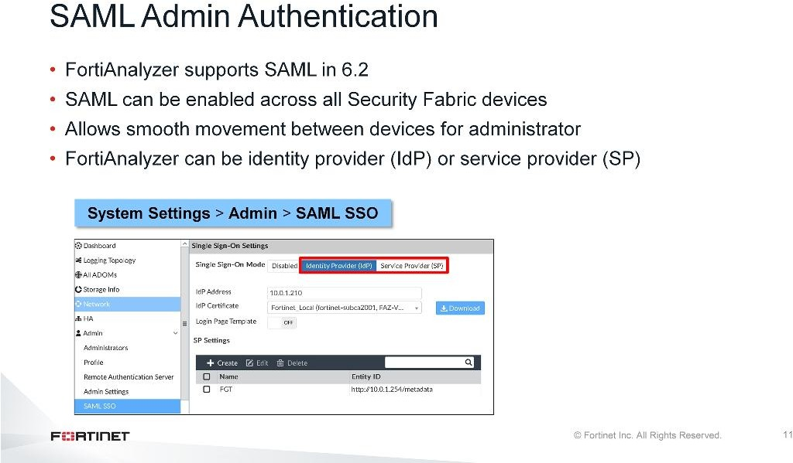
DO NOT REPRINT
© FORTINET
Administration and Management
In 6.2, SAML can be enabled across all Security Fabric devices, enabling smooth movement between devices for the administrator. FortiAnalyzer can play the role of theidentity provider(IdP) or theservice provider(SP) when an external identity provider is available.

Slide 46
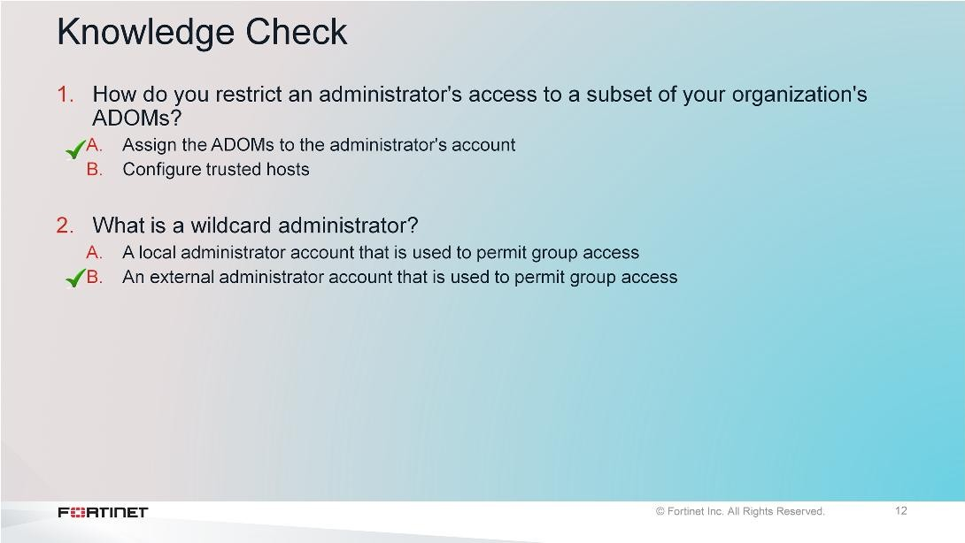
DO NOT REPRINT
© FORTINET
Administration and Management

Slide 47
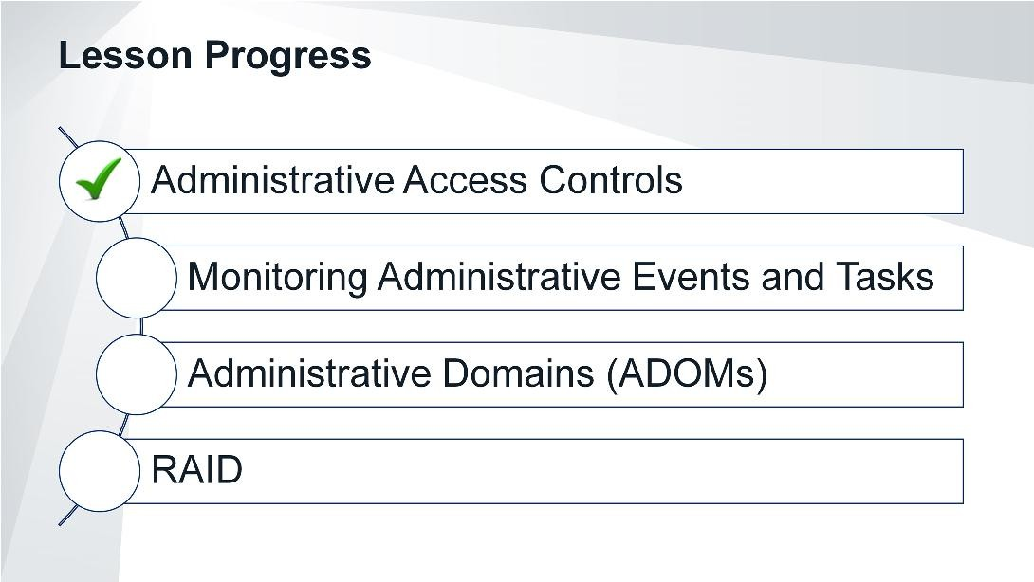
DO NOT REPRINT
© FORTINET
Administration and Management
Good job! You now understand administrative access controls.
Now, you will learn how to monitor events.

Slide 48
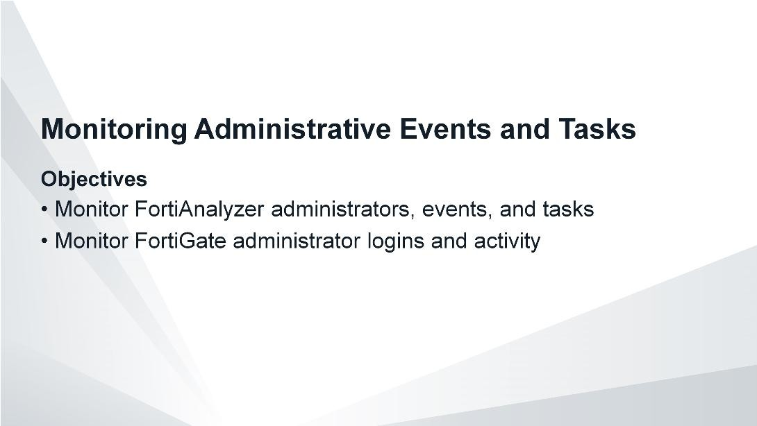
DO NOT REPRINT
© FORTINET
Administration and Management
After completing this section, you should be able to achieve the objectives shown on this slide.
By demonstrating competence in monitoring administrative events and tasks, you will be able to ensure administrators are operating within their assigned role, thereby mitigating risk to your organization.

Slide 49
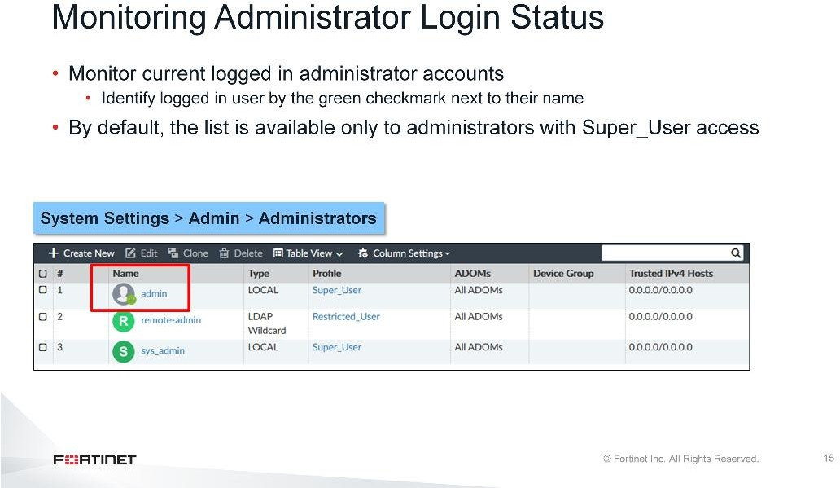
DO NOT REPRINT
© FORTINET
Administration and Management
You can track administrator user sessions, including who is currently logged in and on what trusted host, through theAdministratorspage. By default, only administrators with Super_User access can see the complete administrator’s list.

Slide 50
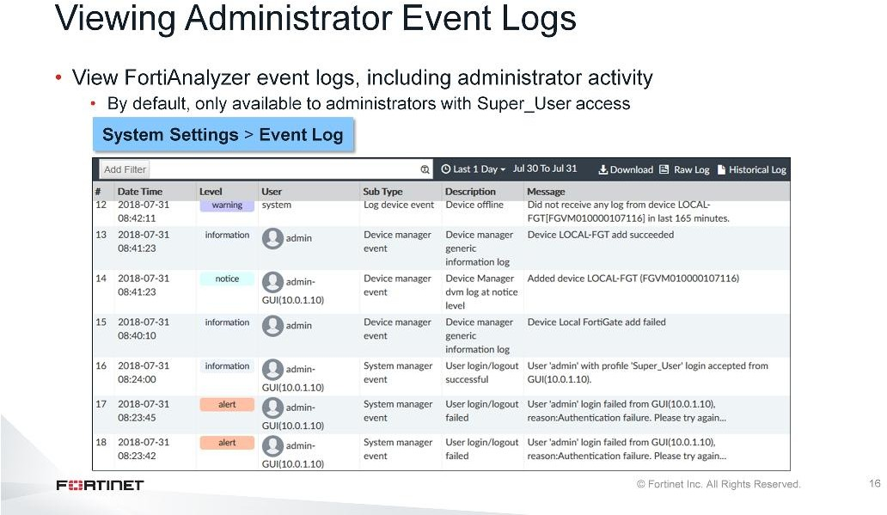
DO NOT REPRINT
© FORTINET
Administration and Management
FortiAnalyzer audits administrator activity, so you can source changes to an individual.
You can view the local event log messages, such as configuration changes and logins, on theEvent Log page. To fine-tune the results, you can add filters. For example, to view local events performed by a specific administrative user, filter by user name.

Slide 51
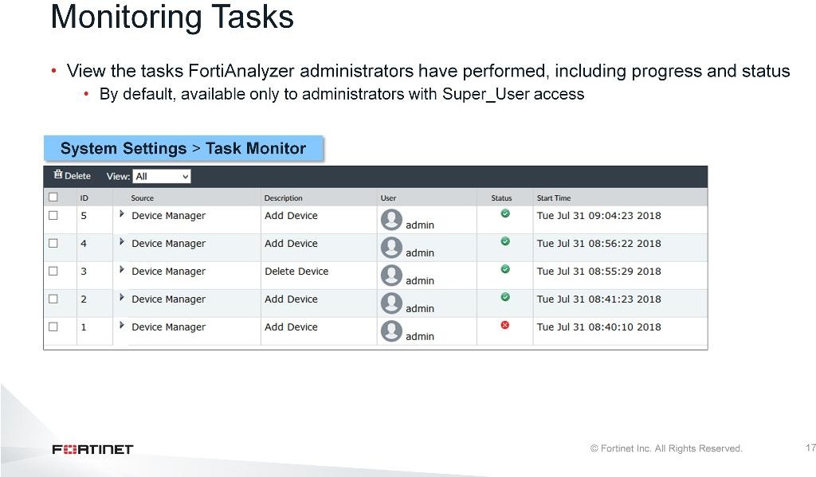
DO NOT REPRINT
© FORTINET
Administration and Management
TheTask Monitorpage allows you to view administrator tasks, as well as the progress and status of those tasks.

Slide 52
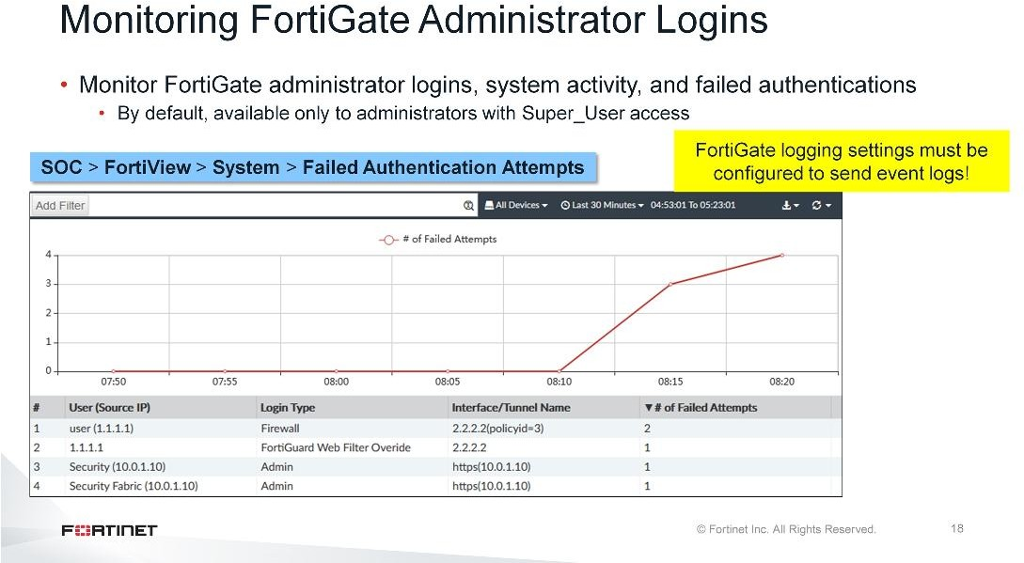
DO NOT REPRINT
© FORTINET
Administration and Management
FortiAnalyzer also allows you to monitor FortiGate administrative login activity throughFortiView.
TheFailed Authentication Attemptspage shows failed login attempts, and includes the source IP of the login, the login type, the interface, and the number of failed login attempts.
TheFortiView>System>Admin Loginspage (not shown on this slide) shows logins, failed logins, login duration, and configuration changes.

Slide 53
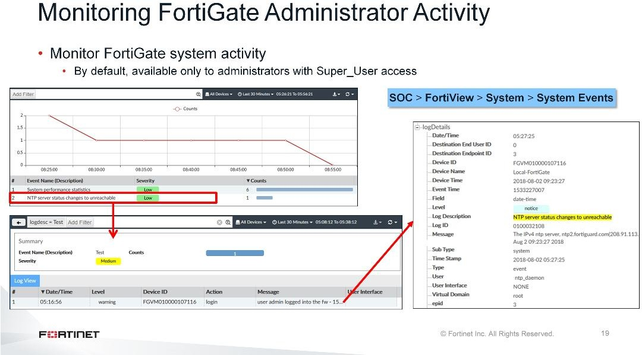
DO NOT REPRINT
© FORTINET
Administration and Management
Finally, FortiAnalyzer allows you to monitor FortiGate administrative activity usingFortiView.
TheSystem Eventspage shows all system and administrator-invoked events. In this example, the Local- FortiGate cannot reach the NTP server. Synchronizing the date and time on all registered servers is important for logging purposes.

Slide 54
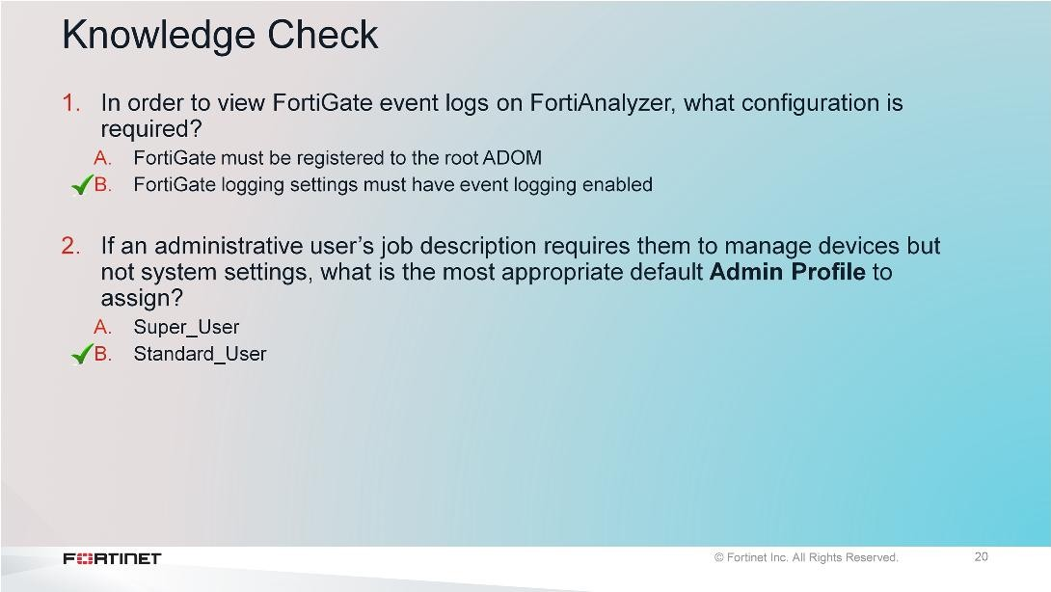
DO NOT REPRINT
© FORTINET
Administration and Management

Slide 55

DO NOT REPRINT
© FORTINET
Administration and Management
Good job! You now understand how to monitor administrative events and tasks.
Next, you will learn about administrative domains, known as ADOMs.

Slide 56

DO NOT REPRINT
© FORTINET
Administration and Management
After completing this section, you should be able to achieve objectives shown in the slide.
By demonstrating competence in administrative domains, you will be able to group devices for administrators to monitor and manage, as well as more efficiently manage data policies and disk space allocation.

Slide 57

DO NOT REPRINT
© FORTINET
Administration and Management
ADOMs are not enabled by default. By default, only administrators with Super_User access can enable and configure ADOMs. You must configure ADOMs are required if you want to register a non-FortiGate device on FortiAnalyzer.
You can enable or disable ADOMs in the GUI throughSystem Settingsor the CLI throughconfig system global. Once you change the ADOM mode, the system logs you out so it can reinitialize with the new settings. The maximum number of ADOMs you can enable varies by FortiAnalyzer model.
After you log in with ADOMs enabled, you must select the ADOM you want to view from your list of configured ADOMs.

Slide 58

DO NOT REPRINT
© FORTINET
Administration and Management
A global ADOM configuration can operate in either normal mode, which is the default mode, or advanced mode.
In normal mode, youcannot assign FortiGate virtual domains (VDOMs) from a single device to multiple FortiAnalyzer ADOMs. You must assign the FortiGate device, and all of its VDOMs, to a single ADOM.
In advanced mode, you can assign FortiGate VDOMs from a single device to multiple FortiAnalyzer ADOMs. This mode allows you to use theFortiView,Event Management, andReportsfunctions to analyze data for individual VDOMs. Advanced mode results in more complicated management scenarios.

Slide 59

DO NOT REPRINT
© FORTINET
Administration and Management
On theAll ADOMspage, you can see all configured ADOMs, as well as the default ADOMs for all non- FortiGate devices. If the default ADOMs do not fit your requirements, you can create your own.
The ADOM type you create must match the device type you are adding. For example, if you want to create an ADOM for a FortiGate, you must select FortiGate as the ADOM type. With FortiGate ADOMs specifically, you must also select the firmware version of the FortiGate device.
Once you create an ADOM, you can set the disk quota. This quota is assigned to the ADOM, and not the individual devices added to it. By Default, theMaximum Alloweddisk quota is set to 50 GB.
Note that you cannot delete default ADOMs. You also cannot delete custom ADOMs with assigned devices until you remove all devices from the ADOM.

Slide 60

DO NOT REPRINT
© FORTINET
Administration and Management
In FortiAnalyzer 6.2, all Fortinet devices in a Security Fabric can be placed into the same ADOM. This allows for fast data processing and log correlation, and also enables combined results to be presented in Reports, SOC Views, Incidents/Events, and more.
After a fabric ADOM is created, it is listed under the Security Fabric section ofAll ADOMs.

Slide 61

DO NOT REPRINT
© FORTINET
Administration and Management

Slide 62

DO NOT REPRINT
© FORTINET
Administration and Management
Good job! You now understand ADOMs.
Next, you will learn about redundant array of independent disks (RAID) and how it applies to FortiAnalyzer.

Slide 63

DO NOT REPRINT
© FORTINET
Administration and Management
After completing this section, you should be able to achieve objectives shown in the slide.
By demonstrating competence in RAID, you will be able to better safeguard your logs in the event FortiAnalyzer stops running.

Slide 64

DO NOT REPRINT
© FORTINET
Administration and Management
Administering and managing your system also includes protecting your log information. This can include introducing redundancy for your log data by making a copy of your logs should your system stop running. The method most commonly used for high performance storage is RAID. RAID is not supported by all FortiAnalyzer models.
RAID enables you to store your data in different places, on multiple hard drives. RAID distributes data across drives in different ways, referred to as RAIDlevels. The level you select depends on your goal. Each level provides a different balance of reliability, availability, performance, and capacity.
You can include most devices in many types of RAID arrays. To set up a RAID array, you must have multiple (at least two) drives that are the same size.
Note that RAID is not a replacement for backing up your logs. You should still back up your logs,even if you employ RAID.

Slide 65

DO NOT REPRINT
© FORTINET
Administration and Management
Basic RAID has two types of operation: mirroring and striping.
With mirroring, instead of writing the file to a single hard drive, it writes the file to another hard drive as well. This way you have a real-time copy of the data. With striping, two or more drives combine into a single logical drive. When data gets stored on the drive, it splits the data into pieces and distributes those pieces across all the drives in the array.
It is important to note that not all RAID versions operate the same way. Some do only mirroring, others do only striping, and some do both. There are also versions that include distributed parity, which is a way to achieve redundancy. With distributed parity, parity data is distributed among multiple drives and requires three or more disks (RAID 5 and above). Also, the number of drives that can fail depends on the RAID level.
Regardless of the level, too many failed drives will result in the loss of data.

Slide 66

DO NOT REPRINT
© FORTINET
Administration and Management
Not all models support RAID, so the menu option to configure RAID may not appear on the GUI. Be sure to check the model specifications to see if RAID is supported, and to what level.
If RAID is supported, you can configure RAID on theRAID Managementpage. Supported levels include: Linear, RAID 0, RAID 1, RAID 1 +spare, RAID 5, RAID 5 +spare, RAID 6, RAID 6 +spare, RAID 10, RAID 50,
and RAID 60.
RAID 10 and 50 are recommended.

Slide 67

DO NOT REPRINT
© FORTINET
Administration and Management
Some common RAID levels are: RAID 0 (striping), RAID 1 and its variants (mirroring), RAID 5 (distributed parity), RAID 6 (dual parity), RAID 50 (striping and distributed parity), and RAID 60 (striping and distributed double parity).
RAID 0 consists of data split evenly across two or more disks. Speed and performance are the main goals. There is no parity information or data redundancy. This means that there is no fault tolerance; if one disk fails, it affects the entire array.
RAID 1 consists of an exact copy of a set of data on two or more disks. Read performance and reliability are the main goals. RAID 1 includes fault tolerance, so if one disk fails the other can keep working since it contains an exact copy of the data.
RAID 5 consists of block-level striping with distributed parity. Data and parity are striped across three or more disks. This RAID level provides better performance than mirroring as well as fault tolerance. It can withstand the failure of a single drive, as subsequent reads can be calculated from the distributed parity, so that no data is lost.
RAID 6 extends RAID 5 by adding another parity block. Accordingly, it consists of block-level striping with two parity blocks distributed across all member disks. It’s more robust than RAID 5, as the system can remain operational, even if two disks fail.

Slide 68

DO NOT REPRINT
© FORTINET
Administration and Management
RAID 10 combines the features of RAID 1 and RAID 0, making sure data is mirrored and spread across multiple drives and disks. RAID 10 balances performance and data security. It's possible to recover data if two drives in a RAID 10 configuration fail, but it's dependent upon which two drives fail.
RAID 50 combines block-level striping of RAID 0 with the distributed parity of RAID 5. Write performance is improved over RAID 5 and it provides better fault tolerance than a single RAID level. With this level, one drive from each of the RAID 5 sets can fail.
RAID 60 combines block-level striping of RAID 0 with the distributed double parity of RAID 6. Write performance is affected, but the enhanced redundancy provides peace of mind. Dual parity allows the failure of two disks in each RAID 6 array.
For more information on RAID levels, see theFortiAnalyzer Administration Guide.
*source: Wikipedia, Standard RAID levels and Nested RAID levels

Slide 69

DO NOT REPRINT
© FORTINET
Administration and Management
On theRAID Managementpage, you can also view the status of each disk in the RAID array and disk space usage.
Disk status states include:
Ready
Rebuilding
Initializing
Verifying
Degraded
Inoperable

Slide 70

DO NOT REPRINT
© FORTINET
Administration and Management
You can view any RAID failures on theAlert Message Consolewidget on the dashboard. A log message appears in this widget if there are any failures.
If a hard disk on a FortiAnalyzer fails, you must replace it. On FortiAnalyzer devices that supporthardware RAID, you can replace the disk while FortiAnalyzer is still running. This is known ashot swapping. Fortinet supports hot swapping on hardware RAID only, so it is recommended that on FortiAnalyzer devices with softwareRAID you should shutdown FortiAnalyzer prior to exchanging the hard disk.

Slide 71

DO NOT REPRINT
© FORTINET
Administration and Management
Use the CLI commanddiagnose system raid statusto view the health of the RAID array as well as the health of the individual disks.
Use the commanddiagnose system raid hwinfoto view detailed information about the hardware for the individual disks on FortiAnalyzer.

Slide 72

DO NOT REPRINT
© FORTINET
Administration and Management

Slide 73

DO NOT REPRINT
© FORTINET
Administration and Management
Congratulations! You have completed this lesson.
Now, you will review the objectives that you covered in the lesson.

Slide 74

DO NOT REPRINT
© FORTINET
Administration and Management
This slide shows the objectives that you covered in this lesson.

Slide 75

DO NOT REPRINT
© FORTINET
Device Registration and Communication
In this lesson, You will learn how to register devices on FortiAnalyzer for log collection, as well as how to troubleshoot communication between FortiAnalyzer and its registered devices. We will also examine FortiAnalyzer disk quota—an important condition for ensuring all logs are collected—and how to manage registered devices.

Slide 76

DO NOT REPRINT
© FORTINET
Device Registration and Communication
In this lesson , you will explore the topics shown on this slide.

Slide 77

DO NOT REPRINT
© FORTINET
Device Registration and Communication
After completing this section, you should be able to achieve the objectives on this slide.
By demonstrating competence in device registration, you will be able to configure FortiAnalyzer to collect logs from registered devices.

Slide 78

DO NOT REPRINT
© FORTINET
Device Registration and Communication
In order for FortiAnalyzer to start collecting logs from a device, it must become a registered device on FortiAnalyzer.
To FortiAnalyzer, there are only two types of external devices: those that are registered and those that are unregistered.
A registered device is one that has beenauthorizedto store logs on FortiAnalyzer, whereas an unregistered device is one that isrequestingto store logs on FortiAnalyzer.
There are two ways you can register a device with FortiAnalyzer.
The first method involves a request for registration from a supported device. When the FortiAnalyzer administrator receives that request, the request is accepted (though it can be denied).
The second method involves the FortiAnalyzer device registration wizard. If the device is supported, and all the details of the device are correct, the device becomes registered.

Slide 79

DO NOT REPRINT
© FORTINET
Device Registration and Communication
Administrators can register each device with an administrative domain, known as an ADOM. However, devices can only be added to theirdevice-specificADOM. For example, a FortiMail device can be registered only with the FortiMail ADOM type.
FortiAnalyzer includes default ADOMs for each device it supports. You can use these ADOMs or you can create your own custom ADOMs. When you create a custom ADOM, it still must be associated with the ADOM type of the device you are adding to it. Note that you can’t add different device types to the same ADOM, whether a default or custom ADOM.
By default, ADOMs are not enabled. Only onerootADOM exists, which is based on the FortiGate ADOM type. As such, with ADOMs disabled, you are unable to register any non-FortiGate device on FortiAnalyzer.

Slide 80

DO NOT REPRINT
© FORTINET
Device Registration and Communication
There are two ways to initiate a request from a supported device.
In the first method, FortiGate requests registration on FortiAnalyzer by enabling remote logging and specifying the FortiAnalyzer IP. Note that if you clickTest Connectivity, an error dialog box opens stating: “Unable to retrieve FortiAnalyzer/FortiManager status”. This is because the FortiAnalyzer administrator has not yet accepted therequest to register—FortiAnalyzer and FortiGate are not yet connected. At this stage, the FortiGate is still an unregistered device.
After the request is made by the supported device, the request automatically appears under the root ADOM in Device Manager. The FortiAnalyzer administrator should review the details of the unauthorized device and, if satisfied, add the device.
During acceptance of the registration request, if ADOMs are enabled, you have the option of keeping FortiGate in the root ADOM or adding it to any custom FortiGate ADOMs you may have configured.

Slide 81

DO NOT REPRINT
© FORTINET
Device Registration and Communication
In this method, the FortiGate administrator enables the Security Fabric. By enabling the Security Fabric, FortiAnalyzer Loggingis enabled by default. By configuring FortiAnalyzer IP on the upstream FortiGate , all the FortiGate devices connected to the upstream FortiGate through the Security Fabric will receive the configuration for FortiAnalyzer and all the FortiGates connected through the Security Fabric will request registration on FortiAnalyzer.
Note that if you clickTest Connectivity, an error dialog box appears stating: “Unable to retrieve FortiAnalyzer/FortiManager status”. This is because the FortiAnalyzer administrator has not yet accepted the request to register—FortiAnalyzer and FortiGates are not yet connected. At this stage, the FortiGates are still an unregistered device.
After the request is made by the supported device, the request automatically appears under the root ADOM in Device Manager. The FortiAnalyzer administrator should review the details of the unauthorized device and, if satisfied, add the device.
During acceptance of the registration request, if ADOMs are enabled, you have the option of keeping FortiGates in the root ADOM or adding it to any custom FortiGate ADOMs you may have configured.
Note that it is recommended to add all the FortiGate devices connected through The Security Fabric under one ADOM. However, it is possible to separate the FortiGate Devices and assign them to different ADOMs.

Slide 82

DO NOT REPRINT
© FORTINET
Device Registration and Communication
With this method, you use the device registration wizard in FortiAnalyzer’sDevice Manager. The FortiAnalyzer administrator proactively initiates, and ultimately performs, the registration. The administrator must have specific details about the device that is to be registered, such as IP address, serial number, device type, model, and firmware version. If the device information verifies, the status reads “Device Added Successfully” and the device appears underDevice Manager.
If ADOMs are enabled, the device is automatically registered to its device-specific ADOM. However, if you’ve already created a custom ADOM and want to add the device directly to that ADOM instead, switch to the ADOMbeforeadding a device using the wizard.

Slide 83

DO NOT REPRINT
© FORTINET
Device Registration and Communication
After you register various Fortinet devices, they appear on theDevice Managertab for that ADOM. You can also view details about the log status and used storage for that ADOM.
Unregistered devices only appear under the root ADOM until registered and assigned to an ADOM.

Slide 84

DO NOT REPRINT
© FORTINET
Device Registration and Communication
When a device is registered, FortiAnalyzer automatically has permission to collect the following types of logs, if they are enabled on FortiGate:
Logs: This log type details information about traffic, events, and security. However, it varies by device, because FortiAnalyzer supports only specific logs types from each device.
DLP archive: This log type details information about any sensitive data trying to get in or out of your network.
Quarantine: This log type details files that have been placed into quarantine on the device.
IPS Packet log: This log type details information about network packets containing the traffic matching IPS signatures.

Slide 85

DO NOT REPRINT
© FORTINET
Device Registration and Communication

Slide 86

DO NOT REPRINT
© FORTINET
Device Registration and Communication
Good job! You now understand how to register a device.
Now, you will learn about ways to troubleshoot communication issues between FortiAnalyzer and your registered devices.

Slide 87

DO NOT REPRINT
© FORTINET
Device Registration and Communication
After completing this section, you should be able to troubleshoot device communication issues.
By demonstrating competence in communication troubleshooting, you will be able to efficiently troubleshoot issues that could prevent log collection.

Slide 88

DO NOT REPRINT
© FORTINET
Device Registration and Communication
This slide shows some basic CLI commands that you can use to check system status, performance, and hardware statistics.

Slide 89

DO NOT REPRINT
© FORTINET
Device Registration and Communication
When using theget system statuscommand to troubleshoot system issues, the following information can be helpful:
Version: Ensure the FortiAnalyzer firmware version is compatible with the device you are registering (see theFortiAnalyzer Release Notesfor supported firmware versions)
Admin Domain Configuration: Ensure ADOMs are enabled if attempting to register a non-FortiGate device.
Current Time: Ensure your date and time is set according to your needs. For many features to work, including scheduling, logging, and SSL-dependent features, the FortiAnalyzer system time must be accurate. While you can manually set the date and time, it is recommended that you synchronize with a Network Time Protocol (NTP) server.
Disk Usage: Ensure you have enough free disk space to accept and store logs from registered devices.
License Status: Ensure you have a valid licence. This is for a VM only.

Slide 90

DO NOT REPRINT
© FORTINET
Device Registration and Communication
When using theget system performancecommand to troubleshoot system issues, look at the used space for CPU, memory, hard disk, and flash disk. If any of these arenearingcapacity, you may experience issues with log collection. The used capacity need not be 100% before you experience problems. For example, the hard disk quota is not fully available for logs, as some of the space is reserved for system usage and unexpected quota overflow. Disk quota is discussed later in this lesson.
For FortiAnalyzer VMs, note that a minimum of 8 GB is recommended for the memory.

Slide 91

DO NOT REPRINT
© FORTINET
Device Registration and Communication
When using thediagnose hardware infocommand to troubleshoot system issues, look at the memory and RAID sections.
The memory information section provides a more granular breakdown of the memory as provided in theget system performancecommand. For example, the total memory fromget system performance actually includes the total memory plus the swap memory. Thediagnose hardware information command shows this breakdown. Swap memory refers to the space available to use when the physical memory is full and the system requires more memory. For a temporary period, inactive pages in memory are moved to the swap space.
If RAID is enabled and being used as a high performance storage solution, the RAID level will impact the determination of disk size and reserved quota level.

Slide 92

DO NOT REPRINT
© FORTINET
Device Registration and Communication
This slide shows the FortiAnalyzer CLI commands you can run to discover what devices and IPs are connecting to FortiAnalyzer; what ADOMs are enabled and configured; and what devices are currently registered and unregistered.

Slide 93

DO NOT REPRINT
© FORTINET
Device Registration and Communication
If you are experiencing communication issues between FortiGate and FortiAnalyzer, first ensure that the two devices can reach each other. Use theexecute pingCLI command on either device to verify that the devices are capable of routing to each other (ping must be enabled and allowed by all intermediate firewalls).
You can also run sniffers on both devices to see if packets that leave FortiGate are reaching FortiAnalyzer. If packets are leaving FortiGate, but not reaching FortiAnalyzer, look at other devices in the network, because an intermediate router or firewall may be blocking the traffic or routing it inappropriately.
Other areas to check:
Is FortiGate configured for remote logging on FortiAnalyzer?
Is the FortiAnalyzer source IP set on FortiGate? This is important if FortiAnalyzer is accessed over a VPN that only allows a specific subnet.
Are the logging filters for logs sent to FortiAnalyzer on FortiGate enabled?
Is FortiGate capable of generating logs and can FortiAnalyzer receive them? If you don’t see any logs on FortiGate, you must examine the logging issue on FortiGate before proceeding with troubleshooting the FortiAnalyzer side.

Slide 94

DO NOT REPRINT
© FORTINET
Device Registration and Communication
You can use the following commands at the same time to troubleshoot communication issues:
Step one:
Run the following command on FortiAnalyzer:
# diagnose debug enable
# diagnose debug application oftpd 8 <FortiGate_IP>
Run the following command on FortiGate:
# diagnose log test
Review the output shown on the slide.

Slide 95

DO NOT REPRINT
© FORTINET
Device Registration and Communication
If FortiAnalyzer becomes unavailable to FortiGate for any reason, FortiGate uses itsmiglogdprocess to cache the logs. There is a maximum value to the cache size, and the miglogd process will drop cached logs. When the connection between the two devices is restored, the miglogd process begins to send the cached logs to FortiAnalyzer. Therefore, the FortiGate buffer will keeps logs long enough to sustain a reboot of your FortiAnalyzer (if you are upgrading the firmware, for example). But it is not intended for a lengthy FortiAnalyzer outage.
On FortiGate, the CLI commanddiagnose test application miglogd 6displays statistics for the miglogd process, including the maximum cache size, and current cache size.
The CLI commanddiagnose log kernel-statswill show an increase infailed-logif the cache is full and needs to drop logs.

Slide 96

DO NOT REPRINT
© FORTINET
Device Registration and Communication

Slide 97

DO NOT REPRINT
© FORTINET
Device Registration and Communication
Good job! You now understand how to troubleshoot communication issues.
Now, you will learn about the FortiAnalyzer disk quota.

Slide 98

DO NOT REPRINT
© FORTINET
Device Registration and Communication
After completing this section, you should be able to achieve the objectives shown on this slide.
By demonstrating competence in understanding disk quota and how to modify it, you will be able to use disk quotas more effectively in your network.

Slide 99

DO NOT REPRINT
© FORTINET
Device Registration and Communication
FortiAnalyzer devices have finite disk space. When the allotted log disk space is full, the following occurs:
An alert message automatically generates on theAlert Message Consoleas an event log with the level
warning
The oldest logs are overwritten. This is the default setting, but you can adjust this behavior to stop logging when the disk is full instead.
No administrator wants to lose valuable log data and run the risk of non-compliance with regard to data retention. As such, it is vital you know your FortiAnalyzer disk quota, how it is enforced, and what space is reserved and thus not available for storing logs.

Slide 100

DO NOT REPRINT
© FORTINET
Device Registration and Communication
Disk quota includes raw logs, archive files, and SQL database tables. Each portion consumes a part of your quota.

Slide 101

DO NOT REPRINT
© FORTINET
Device Registration and Communication
You can obtain your disk log usage, including usage for each ADOM, using the CLI commanddiagnose log device.
The total quota value is determined by subtracting the total system storage from the reserved space. The allocated space is determined by adding the archive and analytics quota for all ADOMs.
The used space is determined by adding the archive and analytics logs and all the system files mounted on the drive. You can receive the system file value by using the CLI commanddiagnose system print df.

Slide 102

DO NOT REPRINT
© FORTINET
Device Registration and Communication
Note that theLicense Informationwidget shows a lower value than the quota. This is because it only reports on the number of logs pushed to FortiAnalyzeron that day. Furthermore, it only reports on the ingress traffic, which is limited to the raw log portion. It doesn’t include log archive, FortiGate store and upload logs, FortiAnalyzer aggregated logs, or FortiClient logs. The SQL database tables are not included either, as this indexing is done by FortiAnalyzerafterthe log has been received.

Slide 103

DO NOT REPRINT
© FORTINET
Device Registration and Communication
By default, each ADOM is allowed 1000 MB (or just under 1 GB) worth of drive space on FortiAnalyzer in order to store log data. However, this number is configurable. You can’t set the minimum below 100 MB, and the maximum depends on the disk space allocation of the specific FortiAnalyzer device. The FortiAnalyzer system reserves between 5%-20% disk space for compression files, upload files, and temporary report files, leaving about 75%-90% disk space for allocation to devices.
It is important to note that if using RAID, the RAID level impacts the determination of disk size and reserved quota level.

Slide 104

DO NOT REPRINT
© FORTINET
Device Registration and Communication
Disk quota enforcement is performed by different processes:
Thelogfiledprocess enforces the raw log file size and is also responsible for disk quota enforcement by monitoring the other processes
Thesqlplugindprocess enforces the SQL database size
Theoftpdprocess enforces the archive file size
Logfiled checks the processes every two minutes (unless system resources are high) andestimatesspace used by the SQL database. If the disk quota (raw + SQL) is estimated to be above 95%, FortiAnalyzer removes the raw logs and the corresponding logs in archives (with the SQL table) until they are down to 85%.

Slide 105

DO NOT REPRINT
© FORTINET
Device Registration and Communication
If ADOMs are enabled, you can adjust your disk quota on theAll ADOMspage. If ADOMs are not enabled, you can adjust your quota fromSystem Storage.
Disk quota calculations are difficult and should be monitored based on the log rate coming from each device. If there is a lot of logging on FortiGate, large devices, or devices with high traffic and UTMs, consider increasing the ADOM disk quota.
Note that by default the disk quota for an ADOM is set to the maximum available disk.

Slide 106

DO NOT REPRINT
© FORTINET
Device Registration and Communication
If increasing disk quota is insufficient based on your monitored log rate, you may need to increase your overall disk space. With FortiAnalyzer VMs, you can dynamically add more disk space to your FortiAnalyzer by using the procedure noted above. However, with hardware FortiAnalyzer, you have to add another disk, as disk space is fixed. If you are using RAID, you will also have to rebuild your RAID array if you add another disk.
So, it is import to account for further growth and size correctly from the outset.

Slide 107

DO NOT REPRINT
© FORTINET
Device Registration and Communication

Slide 108

DO NOT REPRINT
© FORTINET
Device Registration and Communication
Good job! You now understand the FortiAnalyzer disk quota.
Now, you will learn how to manage registered devices.

Slide 109

DO NOT REPRINT
© FORTINET
Device Registration and Communication
After completing this section, you should be able to achieve the objectives shown on this slide. By demonstrating competence in moving devices between ADOM and adding them to HA clusters, you will be able to manage registered devices effectively in your network.

Slide 110

DO NOT REPRINT
© FORTINET
Device Registration and Communication
You can move devices between ADOMs after registration on theAll ADOMspage. While you shouldn’t move devices between ADOMs unless you have to, one such use-case is if you have a mix of low-volume and high- volume log rates in one ADOM. In this situation, it is recommended that you place low-volume log rate devices in one ADOM and high-volume log rate devices in another ADOM. This prevents quota enforcement from adversely affecting low-volume log devices.
You can move devices between ADOMs by editing the custom ADOM to which you want to add the device, and then selecting the device to add to it.
Note that you do not need to move devices into a new ADOM if you upgrade your FortiGate firmware.

Slide 111

DO NOT REPRINT
© FORTINET
Device Registration and Communication
There are some important considerations when moving devices between ADOMs, especially if logs are already being collected for the device you are moving:
What is the disk quota of the new ADOM? Ensure the new ADOM has enough space.
Are the device’s analytics logs required for reports in the new ADOM? If so, you need to rebuild the new ADOM SQL database. When you move a device, only the archive logs (compressed logs) are migrated to the new ADOM. The analytics logs (indexed logs) stay in the old ADOM until you rebuild the database.
Do you want to see the device’s analytics logs in the old ADOM? If no, you need to rebuild the old ADOM SQL database. Otherwise, they will be removed according to the data policy.

Slide 112

DO NOT REPRINT
© FORTINET
Device Registration and Communication
FortiAnalyzer automatically discovers if a FortiGate device is in an HA cluster (this is true of some other Fortinet devices too). However, if you register your device with FortiAnalyzer before adding it to a cluster, you can manually add the cluster within FortiAnalyzer.
With an HA cluster, the only device that communicates with FortiAnalyzer is the primary device in the cluster; the other devices in the cluster send their logs to the primary device, which then forwards them to FortiAnalyzer.
To enable a cluster, edit the registered device on FortiAnalyzer inDevice Managerand enable theHA Clusteroption. You can either add the existing devices to the cluster, or manually enter the serial numbers associated with each device to the cluster.
FortiAnalyzer distinguishes different devices based on their serial numbers. These are found in the headers for all the different log message types.

Slide 113

DO NOT REPRINT
© FORTINET
Device Registration and Communication

Slide 114

DO NOT REPRINT
© FORTINET
Device Registration and Communication
Congratulations! You have completed this lesson. Now, you will review the objectives that you covered in this lesson.

Slide 115

DO NOT REPRINT
© FORTINET
Device Registration and Communication
This slide shows the objectives in this lesson. By mastering the objectives covered in this lesson, you learned how to add, manage, and maintain devices in your network.

Slide 116

DO NOT REPRINT
© FORTINET
Logging
In this lesson, you will learn how to protect, view, and manage logs on FortiAnalyzer. By understanding logging on FortiAnalyzer, you will be able to use log data to reconstruct and analyze network-based attacks, as well as troubleshoot and investigate network issues.

Slide 117

DO NOT REPRINT
© FORTINET
Logging
In this lesson, you will explore the topics shown on this slide.

Slide 118

DO NOT REPRINT
© FORTINET
Logging
After completing this section, you should be able to achieve the objectives shown on this slide.
By demonstrating competence in understanding the purpose of log collection, log storage, and the log file workflow, you will have a better understanding of how logs are compiled and collected.

Slide 119

DO NOT REPRINT
© FORTINET
Logging
Log messages help paint a picture of what is going on in your network. You can determine the load on your network devices, track service usage, and identify any security breaches in your network. However, it is important to understand that logs are like a puzzle—you must put several pieces together in order to get a complete understanding of what is going on. Multiple log messages are often required to determine the exact chain of activity that leads to a breach—a log in isolation often won’t help you to best configure your network to prevent such breaches in the future.
This is why centralized log storage is so important.

Slide 120

DO NOT REPRINT
© FORTINET
Logging
In certain physical areas, and in some areas of business, there are regulations that require and mandate that companies log specific information and store logs for a minimum amount of time.
The regulations often detail the specific types of logs and data required, as those log entries can be used as evidence in cases of unauthorized or illegal activity. The data must be able to stand up in court, so being able to understand and analyze your logs is very important.
Information overflow, however, is a real issue. You want to make sure that whatever information you are logging is enough to satisfy the regulations while still being able to do your job. Having too much data is just as bad (and in some ways worse) than having too little.

Slide 121

DO NOT REPRINT
© FORTINET
Logging
It is important not only to collect and store logs, but to manage them efficiently. If you don’t create best practices to manage your logs, it can result in loss of data and even loss of revenue. Especially if the network attack results in a legal case, it is essential that you provide the appropriate data in court.
Some best practices include the following:
Documenting what is being logged and why. If you ever need to investigate a new event based on your log data, you can look at your document and see what exactly you’re logging so you know if it’s even possible to identify
Ensuring that data for all your devices and applications is being captured and not filtered. Monitor your devices to ensure they are sending logs
Centralizing log storage and storing in a common format. This makes your job easier, since there is no need to check multiple locations in order to look at the log data
Synchronizing the time on all logged devices. If your firewall says it’s 3 AM, your FortiAnalyzer says it 12:30 AM, and your computer says it’s 8:56 AM, cross-referencing logs can be very difficult
Maintaining a backup of logs and implementing a policy that specifies log retention periods
Defining procedures to preserve data integrity
Testing and re-testing your incident response plan to ensure it works and other administrators know their roles

Slide 122

DO NOT REPRINT
© FORTINET
Logging
To be able to analyze and interpret your logs, it is important to understand the different logs types and what information they contain, as well as what logs FortiAnalyzer collects from each supported device.
As you learned in the FortiGate training, there are three log types: traffic logs, event logs, and security logs. Each log type has corresponding log subtypes.
The logs displayed on your FortiAnalyzer are dependent on the device type logging to it and the features enabled. This table illustrates the log types and subtypes FortiAnalyzer collects from various supported devices. Note that you must enable ADOMs in order to support non-FortiGate logging.

Slide 123

DO NOT REPRINT
© FORTINET
Logging
When registered devices send logs to FortiAnalyzer, logs enter the following automatic workflow:
Raw logs are compressed and saved in a log file on the FortiAnalyzer disks. Eventually, when the log file reaches a specific size, it rolls over and is archived.
Logs in the compressed phase are known asarchivelogs. These logs are considered offline and offer no immediate analytic support. If you need to do analysis on the archive logs, you can use the log fetch feature. Log fetching is discussed later in this lesson.
Those same logs are simultaneously indexed in the SQL database to support analysis. The ADOM data policy determines how long these logs are kept in analytics.
Logs in the indexed phase are known asanalyticslogs. These logs are considered online and offer immediate analytic support.
Analytics logs are purged from the SQL database as specified in the data policy, but they still remain compressed in archive. Eventually, that archive is deleted based on the ADOM data policy.

Slide 124

DO NOT REPRINT
© FORTINET
Logging

Slide 125

DO NOT REPRINT
© FORTINET
Logging
Good job! You now understand basic log concepts.
Now, you will learn about ways you can protect your log data.

Slide 126

DO NOT REPRINT
© FORTINET
Logging
After completing this section, you should be able to achieve the objectives shown on this slide.
By demonstrating competence in the different ways you can protect your logs, you will be able to meet organizational or legal requirements for logs.

Slide 127

DO NOT REPRINT
© FORTINET
Logging
You can protect your logs is by using RAID. This allows you to have a copy of your logs should a critical event on your FortiAnalyzer occur. RAID is not supported on all FortiAnalyzer models.

Slide 128

DO NOT REPRINT
© FORTINET
Logging
Even if you use RAID, it is not a replacement for backing up your logs. You can back up your logs through the GUI or CLI.
Log Viewallows you to download a specific filtered view
Log Browseallows you to download rolled logs. FortiAnalyzer also provides the option to upload logs to a FTP, SFTP, or SCP server on a scheduled basis.
The CLI commandexecute backup logssends everything for whatever device or devices you
specify. The data is compressed before being sent, so the transfer doesn’t begin instantaneously. The device needs to process the logs and store them in an archive, which can take some time. This bulk data dump may include a lot of data, so make sure your server has enough disk space.
You can restore logs using the GUI and the CLI.

Slide 129

DO NOT REPRINT
© FORTINET
Logging
To protect your logs during log delivery, you can add redundancy to your environment. In a FortiGate- FortiAnalyzer environment, there are a few options.
One option is to configure FortiGate to send an identical set of logs to a second logging server, such as a second FortiAnalyzer or a syslog. Note that this will increase the load on the FortiGate appliance, as the log daemon must handle an additional TCP connection to the second log device. However, with proper system sizing, this additional load will not be a factor. This option is not available for smaller FortiGates that do not support a second device.
Another option is to set up log forwarding in Aggregation mode. Generally, your central (aggregating) device is going to be a larger FortiAnalyzer, but this is not a requirement. The Collector will send a delta (incremental changes) of the logs to the aggregation server. The two devices compare what they have stored and the Collector sends only what the Analyzer doesn’t have. This not only reduces the amount of traffic that is sent, but it also provides a level of redundancy. If there’s a catastrophic failover of the Analyzer device, the Collector sends all of the data it has and repopulates the Analyzer automatically. Aggregation mode is only supported between two FortiAnalyzer devices.

Slide 130

DO NOT REPRINT
© FORTINET
Logging
Log forwarding can run in modes other than aggregation mode, which is only applicable between two FortiAnalyzer devices. FortiAnalyzer can also forward logs in realtime mode to a syslog server, a Common Event Format (CEF) server, or another FortiAnalyzer. The FortiAnalyzer that forwards logs to another plays the role of the client, while the recipient plays the role of the server.
To configure log forwarding, you must complete the following:
Set the log forwarding mode : aggregation or forwarding.
Forwarding mode forwards logs as they are received. It does not forward content files (DLP, antivirus quarantine, and IPS).
Aggregation mode stores logs and content files and uploads to the FortiAnalyzer server at a scheduled time.
Configure the server (the log recipient).
Configure the client (the FortiAnalyzer forwarding the logs). Here you can also specify which device’s logs to forward and set log filters to only send logs that match filter criteria.
In addition to forwarding logs, the FortiAnalyzer client retains a local copy of the logs. The local copy of logs are subject to the data policy settings for archive logs on the FortiAnalyzer client.

Slide 131

DO NOT REPRINT
© FORTINET
Logging
Finally, you can protect your logs by encrypting the log communication between devices.
OFTP is used over SSL when information is synchronized between FortiAnalyzer and FortiGate. OFTP listens on ports TCP/514 and UDP/514.
OFTPS is the default setting for securing communications between FortiGate and FortiAnalyzer.
SSL communications are auto-negotiated between FortiAnalyzer and FortiGate, so the oftp server will use SSL-encrypted FTP, only if it is being used by the connecting FortiGate. By default, FortiGate uses thedefault encryption level and FortiAnalyzer uses thelowencryption level. FortiAnalyzer’s encryption level must be equal to, or less than, FortiGate’s.

Slide 132

DO NOT REPRINT
© FORTINET
Logging
To prevent logs from being tampered with while in storage, you can add a log checksum using theconfig system globalcommand. You can configure FortiAnalyzer to record a log file hash value, timestamp, and authentication code when the log is rolled and archived and when the log is uploaded (if that feature is enabled). This can also help against man-in-the-middle only for the transmission from FortiAnalyzer to an SSH File Transfer Protocol (SFTP) server during log upload.
The following log checksums are available:
md5: Record log file’s MD5 hash value only
md5-auth: Record log file’s MD5 hash value and authentication code
none: Do not record the log file checksum
You can also change the OFTP certificate to a custom one using theconfig system certificate oftp command. You require a privacy enhanced mail (PEM) formatted certificate and associated PEM formatted private key.

Slide 133

DO NOT REPRINT
© FORTINET
Logging

Slide 134

DO NOT REPRINT
© FORTINET
Logging
Good job! You now understand how to protect your logs.
Now, you will learn about ways to view and search your logs in FortiAnalyzer.

Slide 135

DO NOT REPRINT
© FORTINET
Logging
After completing this section, you should be able to achieve the objectives shown on this slide.
By demonstrating competence in viewing logs, log summaries, and dashboards, you will be able to find and view a variety information related to logs.

Slide 136

DO NOT REPRINT
© FORTINET
Logging
Log Viewallows you to view traffic logs, event logs, and security logs information for each ADOM. You can restrict the log view to one or more devices in the ADOM or to a log group, which is a group of devices placed together in a single logical object.
Log groups are virtual. They don’t have SQL databases or occupy additional disk space.

Slide 137

DO NOT REPRINT
© FORTINET
Logging
To search for specific logs inLog View, select the log type from the left menu and then set appropriate filters. In the example shown on this slide, the filter is set to the category description “Malicious Websites”. You can also specify all devices within an ADOM or a specific device within the ADOM, and set the time frame.
You can also change your view by adding or removing columns and viewing logs in real time or historical, or as raw or formatted logs.
To view more information about a log, double-click the log entry. The details pane appears on the right side of the screen.

Slide 138

DO NOT REPRINT
© FORTINET
Logging
You can save frequent searches as a custom view using theCustom Viewicon on the tool bar. Set your filters, conduct your search, and then save the search under a custom view.

Slide 139

DO NOT REPRINT
© FORTINET
Logging
If your search filters don’t return any results when the log data does exist, the filter may be poorly formed. FortiAnalyzer looks for an exact match in the log, so you must form the SQL search string correctly.
Here are some tips for log searches or troubleshooting log searches:
Verify thatCase Sensitive Searchis enabled in theToolsmenu. Disable for increased search flexibility.
Find a log in the log table that includes data that you want to search for. For example, if you want to search for attacks that include code injections, right-click on that data, and a pop-up appears with the search filters automatically set for you. If you select the search filter, it returns the results based on that filter.
When setting a filter, you can select an existing filter option in the drop-down list, or type your own filter name. If you don’t know the proper filter name as it appears in the SQL table, enable the column using Column Settings(you may need to refresh the page after). The filter then appears as an option in the drop-down list.

Slide 140

DO NOT REPRINT
© FORTINET
Logging
FortiView is another way to view log data. FortiView integrates real-time and historical data into single, summary views. Only data from analytics logs are available. Data from archive logs are not displayed. Each ADOM has its own data analysis in FortiView, so ensure you are in the correct ADOM before viewing the contents of FortiView.
Starting with v6.2, FortiView is now part of SOC.

Slide 141

DO NOT REPRINT
© FORTINET
Logging
FortiView allows you to view summaries of log data in both tabular and graphical formats for FortiGate and FortiCarrier. For example, you can view top threats to your network, top sources of network traffic, and top destinations of network traffic, to name a few. For each summary view, you can drill down into details as well as set filters to display specific data.

Slide 142

DO NOT REPRINT
© FORTINET
Logging
One FortiView worth mentioning is Indicator of Compromise (IOC). The IOC engine detects end users with suspicious web usage compromises by checking new and historical logs against the IOC signatures, which are based on a FortiGuard subscription.
The breach detection engine on FortiAnalyzer uses FortiGuard Threat Detection Service (TDS) intelligence to analyze web filter logs for breach detection. TDS intelligence updates daily to reflect the real world threat landscape. Note that the logs from AV/IPS, and so on, won't be used since those threats have already been detected or prevented by these services on FortiGate. When a threat match is found, a threat score is given to the end user based on the overall ranking score from TDS. When the check is completed, FortiAnalyzer aggregates all the threat scores of an end user and gives its verdict on the overall IOC of the end user. The verdict can be one of the following:
Infected: Indicates a real breach. A match or matches of the blacklisted IPs/domain generation algorithms (DGAs) have been found in the web logs.
Highly Suspicious:Indicates a possible breach.
For reporting and a more historical audit of detections of malware, botnet, and intrusions, you can look at the threat report.

Slide 143

DO NOT REPRINT
© FORTINET
Logging
In order to configure IOC, you require the following:
A threat detection service (TDS) package from FortiGuard
A one-year subscription to IOC. Note that FortiAnalyzer does include an evaluation license, but it is restrictive and only meant to give you an idea of how the feature works.
A FortiGuard TDS services subscription for FortiAnalyzer
A Web filter services subscription on FortiGate(s)
Web filter policies on FortiGate(s) that send traffic to FortiAnalyzer

Slide 144

DO NOT REPRINT
© FORTINET
Logging
Here is an example of an IOC hit inFortiView. The breach detection engine has determined a real breach, as indicated by theInfectedverdict. The# of Threatscolumn indicates there are 10 different threats associated with this hit.
You can also see two major types of intelligence:
Blacklist, which includes malicious IPs for botnets and DNS sinkhole, as well as domain names by DGA.
Suspicious list, where each URL is associated with a ranked score. The ranked score is relative based on threat intelligence crowdsourcing—which is processed once a day.
On the IOC FortiView, you can:
Filter the entries by adding filters, as well as specifying devices or a time period. You can view up to 7 day’s history—each detection using that day’s threat intelligence.
Acknowledge the IOC by clickingAckin theAcknowledgecolumn (you can still view acknowledged IOCs)
Double-click an entry to drill-down and view threat details.

Slide 145

DO NOT REPRINT
© FORTINET
Logging
In FortiView, if the IP addresses are not resolved to a hostname, you must configure local DNS servers on FortiAnalyzer. Then, enter the CLI command shown on this slide.
This will induce a slight delay on every FortiView refresh because it needs to resolve. In very large environments, the delay may be more noticeable, depending on the number of IPs that need to resolve, as well as the speed of your DNS servers.
As a best practice, it is recommended to resolve IPs on the FortiGate end. This is because you get both source and destination, and it offloads the work from FortiAnalyzer. On FortiAnalyzer, this IP resolution does destination IPs only.

Slide 146

DO NOT REPRINT
© FORTINET
Logging
Using FortiAnalyzer, you can enable log fetching. This allows FortiAnalyzer to fetch the archived logs of specified devices from another FortiAnalyzer, which you can then run queries or reports on for forensic analysis. Log fetching greatly simplifies the generation of reports based upon log data by:
Allowing the administrative user to select the devices and time period to be indexed
Allowing customized log retention settings for the indexed logs pulled into the ADOM to suit the purpose of report generation based on older logs
Avoiding log duplication, which can occur during an import from an external backup source
The FortiAnalyzer device that fetches logs operates as the fetch client, and the other FortiAnalyzer device that sends logs operates as the fetch server. Log fetching can happen only between two FortiAnalyzer devices, and both of them must be running the same firmware version. A FortiAnalyzer device can perform either the fetch server or client role, and it can perform two roles at the same time with different FortiAnalyzer devices at the other end. You can establish only one log-fetching session at a time between two FortiAnalyzer devices.
If you only have one FortiAnalyzer, log fetching is not an option. In this case, you would export and import the log file. You may want to delete the exported log file from the FortiAnalyzer prior to reimporting, so you would not have a duplicate copy of those logs in your archive.

Slide 147

DO NOT REPRINT
© FORTINET
Logging
The SOC (Security Operations Center) is designed for a network and security operations center where multiple dashboards are displayed in large monitors in a SOC environment.
SOC displays both real-time monitoring and historical trends. This centralized monitoring and awareness help you to effectively monitor network events, threats, and security alerts.
Use SOC dashboards to view multiple panes of network activity, including monitoring network security, compromised hosts, vulnerabilities, security fabric, WiFi security, and system performance.

Slide 148

DO NOT REPRINT
© FORTINET
Logging
SOC dashboards and widgets are very flexible and allow you to do the following:
Create predefined or custom dashboards.
Add, delete, move, or resize widgets for both predefined and custom dashboards.
You can add the same dashboard multiple times on the same or different monitors.
Monitor one activity on each widget.
Add the same widget multiple times and apply different settings to each one. For example, you can add widgets to monitor the same activity using a different chart type, refresh interval, or time period.
Resize widgets or display a widget in full screen.
For example, if one dashboard has too many widgets, simply create the same or a different dashboard on another monitor to display widgets in a bigger size.

Slide 149

DO NOT REPRINT
© FORTINET
Logging
SOC includes predefined dashboards for Security Monitor, Compromised Hosts Monitor, Vulnerabilities Monitor, Security Fabric, WiFi Monitor, and Local System Performance.
Security MonitorIncludes following widgets:
oTop Threat Destinations, Top Threats, Top Applications, Top Endpoint Vulnerabilities, Top Sources, Top Countries, Top Dialup VPN, VPN Site-to-Site, FortiSanbox – Scanning Statistics, FortiSandbox - Top Malicious & Suspicious File Users
Compromised Hosts Monitor
oThis monitor has only one widget showing compromise hosts. By default, this widget includes two panes: Compromised Hosts and Compromised Hosts Incidents.
Local System Performance
oThis dashboard monitors the system performance of the FortiAnalyzer unit running NOC and SOC and not the logging devices. It includes CPU & Memory Usage, Multi-Core CPU Usage, Insert Rate vs Receive Rate, Receive Rate vs Forwarding Rate, Disk I/O.

Slide 150

DO NOT REPRINT
© FORTINET
Logging

Slide 151

DO NOT REPRINT
© FORTINET
Logging
Good job! You now understand how to view and search your logs.
Now, you will learn how to troubleshoot and manage your logs.

Slide 152

DO NOT REPRINT
© FORTINET
Logging
After completing this section, you should be able to achieve objectives shown on this slide.
By demonstrating competence in troubleshooting and managing your logs, you will be able to ensure you do not lose valuable log data.

Slide 153

DO NOT REPRINT
© FORTINET
Logging
In order to understand your log volume and whether your disk quota is configured appropriately, you can use the CLI commands shown on this slide to gather log rate and device usage statistics. For example, if your log volume is too high, you won’t be able to keep your logs in analytics and archive for the amount of time configured in the ADOM.
Run# diagnose debug enablebefore running the commands shown in the slide.

Slide 154

DO NOT REPRINT
© FORTINET
Logging
You can also view log insert rate, receive rate, and log insert lag time using the respective dashboard widgets.
By default, these widgets are not added to the dashboard. To add, you can click onToggle Widgetson the top left and add these widgets.
Insert Rate vs. Receive Rateis a graph that shows the rate at which raw logs reach the FortiAnalyzer (received rate) and the rate at which they are indexed (insert rate) by the SQL database and the sqlplugind daemon.
Log Insert Lag Timeshows the amount of time between when a log was received and when it was indexed.

Slide 155

DO NOT REPRINT
© FORTINET
Logging
Based on your log rate and device usage statistics, you may need to adjust your ADOM disk quota so you don’t lose valuable log data.
Always monitor your log rate for each device in the ADOM. If you have a high volume of logs, increase the ADOM quota so the oldest logs are not lost prematurely.
Allocating insufficient quota to an ADOM can cause many problems. It can:
Prevent you from reaching your log retention objective
Cause unnecessary CPU resources enforcing quota with log deletion and database trims, and
Adversely affect reporting if the quota enforcement acts on analytical data before a report is complete.

Slide 156

DO NOT REPRINT
© FORTINET
Logging
Aside from increasing your disk log quota, what can you do to better manage your logs on disk?
You can:
Specify a global log roll policy to roll or upload logs when the size exceeds a set threshold
Specify a global automatic deletion policy for all log files, quarantined files, reports, and content archive files on FortiAnalyzer

Slide 157

DO NOT REPRINT
© FORTINET
Logging

Slide 158

DO NOT REPRINT
© FORTINET
Logging
Good job! You now understand how to troubleshoot and manage your logs.
Now, you will learn how to monitor events.

Slide 159

DO NOT REPRINT
© FORTINET
Logging
After completing this section, you should be able to achieve objectives shown on this slide.
By demonstrating competence in event handlers, you will be able to improve your efficiency in investigating events.

Slide 160

DO NOT REPRINT
© FORTINET
Logging
In the GUI, theEvent Managerscreen shows all events generated by your enabled and configured event handlers.
Double-clicking an event provides more details about the event including the associated logs. It also allows you to leave a comment for your records, and to acknowledge the event.
Event handlers work in raw logs, not in the database logs.

Slide 161

DO NOT REPRINT
© FORTINET
Logging
Event handlers are specific matched conditions in the raw logs that display inEvent Management.
The system includes a number of predefined event handlers that you can enable to start populatingEvent Management. You can also configure event handlers to send alert notifications by email, as SNMP traps, or to a syslog server. In order to use any of these notification methods, you must first set up the back end (for example, an email server for email notifications).
If none of the predefined event handlers meet your requirements, you can create custom event handlers.

Slide 162

DO NOT REPRINT
© FORTINET
Logging
When configuring an event handler, the generic text filter allows more precise and flexible control over which logs trigger an event. Multiple operators and logic are supported. You can hover your cursor over the question mark for an example.
As a tip, you can search your raw logs for the log file on which you want to add an event handler and copy the string you wish to match.

Slide 163

DO NOT REPRINT
© FORTINET
Logging
You can now create custom messages in event handlers in the newAdditional Infofield. You can use the default information or configure a custom message. The custom message can include variables and log fields. Use this feature to provide custom information including specific details from fields and variables.
This additional information can be included in email notifications or passed to ITMS platforms such as ServiceNow. Using this feature, you can see the event details without going into the logs.

Slide 164

DO NOT REPRINT
© FORTINET
Logging

Slide 165

DO NOT REPRINT
© FORTINET
Logging
Congratulations! You have completed this lesson.

Slide 166

DO NOT REPRINT
© FORTINET
Logging
Here are some logging best practices:
Upload FortiAnalyzer local logs to a remote server
Increase local event logging level to debug
Configure SNMP traps for critical system events
Configure log upload for rolled logs on a daily basis

Slide 167

DO NOT REPRINT
© FORTINET
Logging
This slide shows the objectives covered in this lesson. By mastering the objectives covered in this lesson, you learned how to use logs effectively in your system.

